Slide 2
Substance Use and Traumatic Brain Injuries:
An Approach
Enid Watson, MDiv
Director, Screening & Early Identification
MA FASD State Coordinator
Institute for Health and Recovery
enidwatson@healthrecovery.org

Slide 3
Today’s Agenda
Brief Overview of Substance Use Disorders, including traditional treatment approaches
Co-Occurring Disorders
TBI and Substance Use
Screening Clients for Substance Use: CRAFFT
Engagement Strategies for Working with Clients who use substances
  Motivational Interviewing
  Adaptive Functioning Approaches
  12 Step Model and Tips
GAMES
Videos
Dialogue

Slide 4


When you were young, did you dream of growing up to become addicted to alcohol or other drugs?

Slide 6
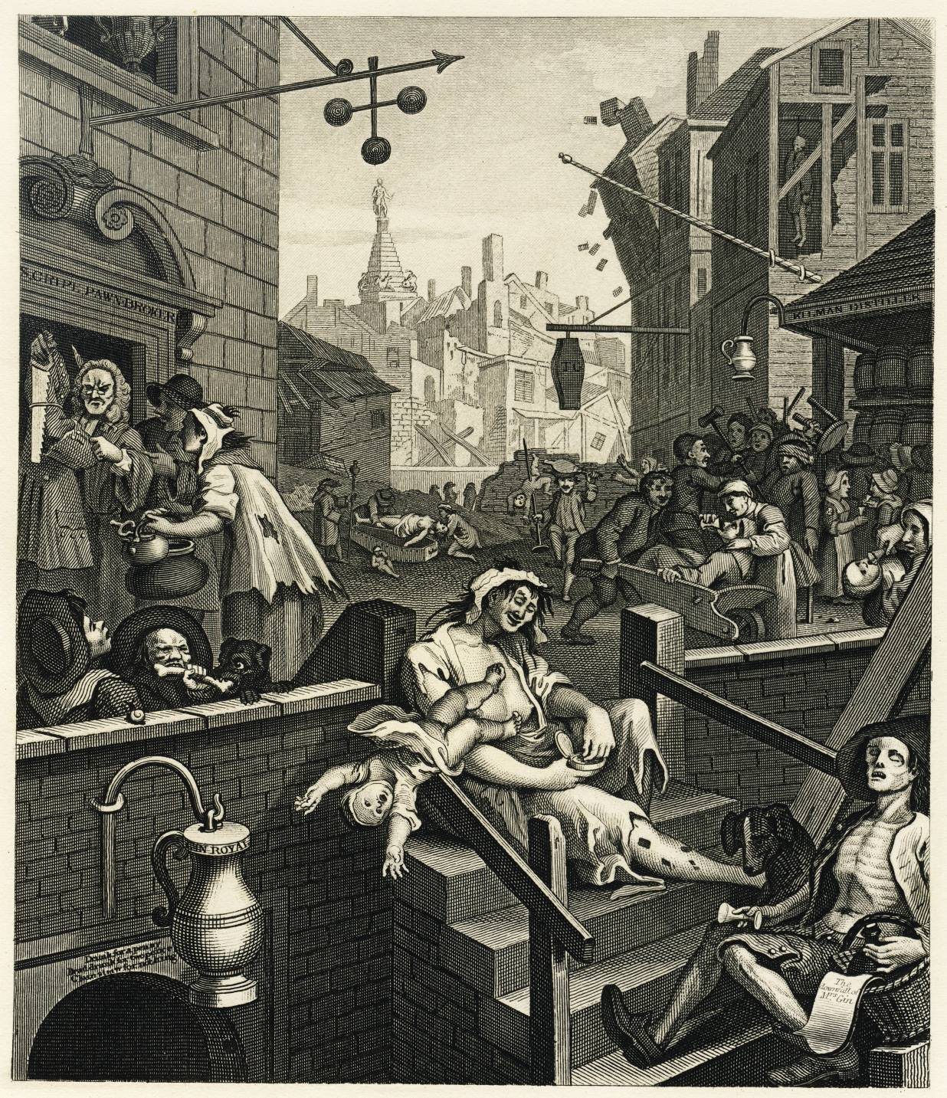
Engraving by William Hogarth
Gin Lane
1750

Slide 7
Mothers With Substance Use Disorders
Stigma, guilt & shame
  Low social tolerance of addiction in women, judgmental attitudes & punitive approaches
  Sexualized image – seen as promiscuous
  Stereotype of bad, uncaring mother
  Believe themselves to be failures in general, poor mothers not deserving of help
Powerlessness, hopelessness, despair
Lack of trust – fear of loss of children
Anger & blame from caregivers

Slide 8
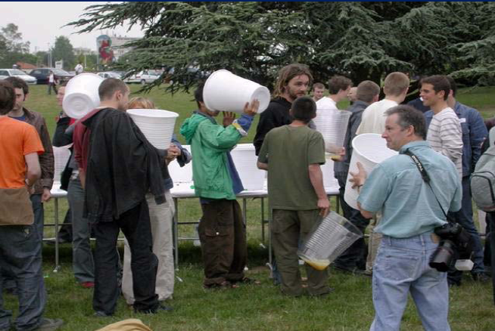
What is A Drink?

Slide 9

But I only had one drink…
The Full Bottle Wine Glass

Slide 10
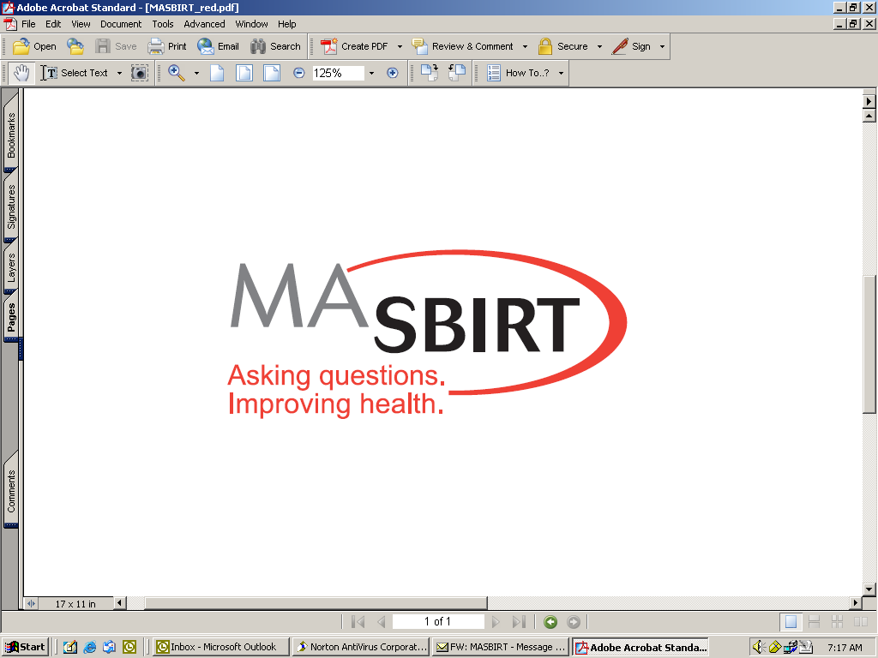
Notes:
10

Slide 12
Risky Use (Adults)
ALCOHOL: NIAAA recommends:
  Men (healthy & under 65 years)
      No more than 4/occasion or 14/week
  *Women
  Men (healthy & over 65 years)
      No more than 3/occasion or 7/week
  *Pregnant women and those planning to become pregnant abstain from alcohol use
  People with medical conditions and people on medications speak with their doctor about alcohol use.
  DRUGS
  Any illicit drug use or any prescription drug misuse is considered unhealthy
http://pubs.niaaa.nih.gov/publications/Practitioner/CliniciansGuide2005/guide.pdf

Slide 13
1 Drink for Females = 2 Drinks for Males
Metabolize alcohol differently
Female bodies contain < water and > fatty tissue so that alcohol is less diluted in the bloodstream and retained in the body longer
Decreased activity of an enzyme (ADH) that breaks down alcohol
Estrogen may affect metabolism
=
note
Notes:
So, if a woman wants to keep up with her heavily drinking boyfriend, she could develop serious health problems. Enid will talk more about this in the sub use training in March.

Slide 14
Prevalence of Lifetime Diagnosis of Alcohol Dependence by Age of Onset of Drinking
% Lifetime Dx. Alc. Dep.
Age began drinking
©2007 Center for Adolescent
Substance Abuse Research,
Children’s Hospital Boston. All rights reserved.
Source: Hingson et al., 2006
Notes:
Adolescent Substance Abuse: New Strategies for Primary Care
14
If your participant drank heavily during adolescence, for example, that adult would be at greater risk of developing a SUD.

Slide 15
Common Models of Addiction
Biological & Disease Model
The disease and biological theories of addiction are very similar. However the disease model highlights the differences between people with the disease and those without it. In contrast, the biological model focuses on the genetic risks for developing the disease of addiction.

Slide 16
Disease Model of Addiction
According to this model, addiction is a brain disease. It is characterized by altered brain structure and functioning. These brain abnormalities cause persons with this disease to become addicted to substances or activities.
This model considers addiction irreversible once acquired.

Slide 17
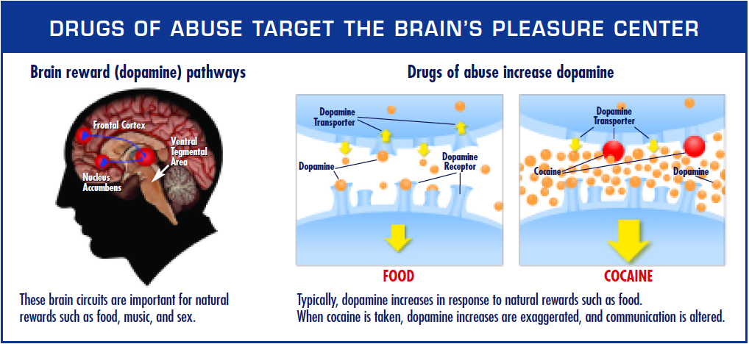
Addiction is a Disease

Slide 18
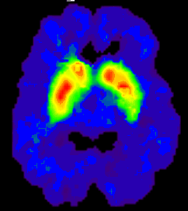
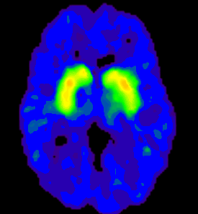
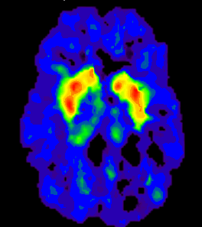

Partial Recovery of Brain Dopamine Transporters in Methamphetamine
Abuser After Protracted Abstinence
3
0
ml/gm
Normal Control
METH Abuser
(1 month detox)
METH Abuser
(24 months detox)
Source: Volkow, ND et al., Journal of Neuroscience 21, 9414-9418, 2001.
And Barry Lester, Ph.D.

Slide 19
Substance Use Disorders
Goodbye, “Substance Abuse” and
“Substance Dependence”
Hello, “Substance Use Disorders”

Slide 20
DSM-5 Substance Use Disorders
1. Impaired control: (1) taking more or for longer than intended, (2) unsuccessful efforts to stop or cut down use, (3) spending a great deal of time obtaining, using, or recovering from use, (4) craving for substance.
2. Social impairment: (5) failure to fulfill major obligations due to use, (6) continued use despite problems caused or exacerbated by use, (7) important activities given up or reduced because of substance use.
3. Risky use: (8) recurrent use in hazardous situations, (9) continued use despite physical or psychological problems that are caused or exacerbated by substance use.
4. *Pharmacologic dependence: (10) tolerance to effects of the substance, (11) withdrawal symptoms when not using or using less. * Persons who are prescribed medications such as opioids may exhibit these two criteria, but would not necessarily be considered to have a substance use disorder.

Slide 21
DSM-5 SUD Diagnostic Scoring
Mild Presence of 2-3 symptoms
Moderate Presence of 4-5 symptoms
Severe Presence of 6 + symptoms

Slide 22
SUD: True or False?
Relapse = failure
Detox = cure
Illegal use = addiction
Abstinence is the only goal
Binge Drinkers are dependent on alcohol
Medication-Assisted Treatment is still “using”
Relapse is part of recovery
Detox is the first step
Use varies widely
Benefits in harm reduction
90% Bingers are not dependent
MAT is simply medication for a chronic disease

Slide 23
Treatment (Tx) Modalities
Detoxification/Acute Tx
Short term residential:
  Clinical Stabilization Services (CSS)
  Transitional Support Services (TSS)
Outpatient Counseling
Methadone/Suboxone
Residential Tx
Housing and Homelessness
Driving Under the Influence

Slide 24
Selected Pharmocotherapy
Methadone: Length of tx improves outcomes; appropriate for pregnant women:
Buprenorphine/Suboxone/Subutex: (opiates, oxycontin, vicodin): Physician-assisted, research on pregnancy indicates positive results are possible.
Antabuse: (ETOH), “sick” feelings, poor compliance
Naltrexone: (ETOH and opiates), reduces cravings; timing of dose critical
Campral: (ETOH), Acomprosate Calcium. Restores neurotransmitter system
Vivitrol ® : (ETOH and opiates), monthly injection of Naltrexone
        Jackson, 2004
Notes:
Although eventual goal is to be drug-free, pharmocology may be helpful tool. Compliance is crucial, and with it relapse is often prevented.
Adjunctive therapy is also crucial.
Acomprosate: mostly efficacious with low degrees of mental illness, naltrexone especially for high baseline depression.
Methadone: often not accepted in traditional self-help groups. Lower doses tend to result in higher relapse rates.
Relapse rates similar for campral and natlrexone

Slide 25
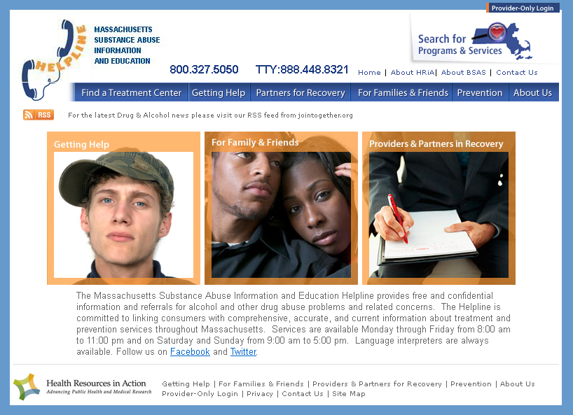
Referral to Treatment www.helpline-online.com

Slide 26
Adverse Childhood Events (ACE) Study
Kaiser Permanente (Felitti) & CDC (Anda)
Large-scale epidemiological study of influence of stressful/traumatic childhood experiences
Interviewed more than 17,000 people
Investigating adverse childhood experiences and adult health status

Slide 27
ACE Study
Recurrent & severe physical abuse | 11%
Recurrent & severe emotional abuse | 11%
Contact sexual abuse | 22%
Growing up in a household with:
Alcoholic or drug-user | 25%
Member being imprisoned | 3%
Mentally ill, chronically depressed, or institutionalized member | 19%
The mother being treated violently | 12%
Both biological parents NOT present | 22%
Felitti, 2003

Slide 28
ACE Study
Scoring: one point for each category of ACEs before 18
ACES not only common, but effects were cumulative
Compared to persons with ACE score of 0, those with ACE score of 4 or more were 2x more likely to be smokers, 12x more likely to have attempted suicide, 2x more likely to be alcoholic and 10x more likely to have injected street drugs

Slide 29

“It felt like a warm soft hug.”
- Childhood abuse survivor describing her first use of heroin
Notes:
When a mother holds her child the child and mother’s brains release dopamine and other pleasure chemicals. The need for human love and affection is just that, human. We are born seeking connection with others and for most that first connection is made with our parental figures. Many trauma survivors may not have been provided that love and connection. The human need for connection and love was never met. In many cases the opposite of a loving caring connection was what the child experienced. This does not mean that as survivors we learned to turn off our need for love. We still have the human need for love and connection as a drive, but since it is through our relationships with others that we were harmed, we avoid or have not learned to meet this need through our connections with others in healthy ways. The use of heroin and other drugs that affect the dopamine system may be one way that trauma survivors have learned to receive that same sense of love and care, but in a maladaptive way.

Slide 30
Early
Death
Disease,
Disability
Adoption of
Health-Risk Behaviors
Social, Emotional, and
Cognitive Impairment
Adverse Childhood Experiences
Death
Birth
The Influence of Adverse Childhood Experiences Throughout Life
ACE’s Major Determination of Health & Well Being
Felitti, 2003

Slide 31
“Denial”
Is a central part of addiction
Denial is progressive: the greater the pain and the less the hope, the more rigid the denial
Unconscious, not deliberate lying and deception
Will not be given up without a struggle
Preserves self-worth & dignity
Creates a false sense of being in control

Slide 32
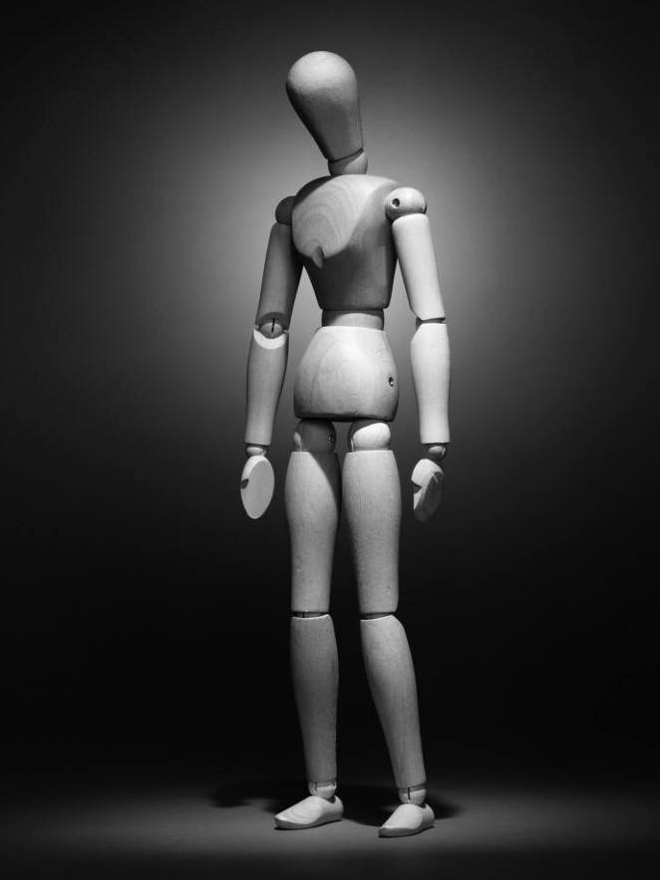
Forms of Denial
Minimizing
Blaming
Rationalizing
Diversion
Hostility/anger
Notes:
What does it look like among clients in your program?

Slide 33
A Poem About Denial
Tread gently when you walk into my life
For around the body of my soul I have gathered
Fragile gossamer, to the floor of little lies
Not to deceive you - but to protect me.
Do not pull at them to render my soul naked
For they hide truths I have not yet the strength to face and
When they are gone I may perish
In the cold realities of your judgment I may die.
But let me stand protected awhile
Talk to me in love and when I am secure in that
Those lies will fall away as un-needed peel
Revealing the fruit, the feast.
(anonymous)

Slide 34
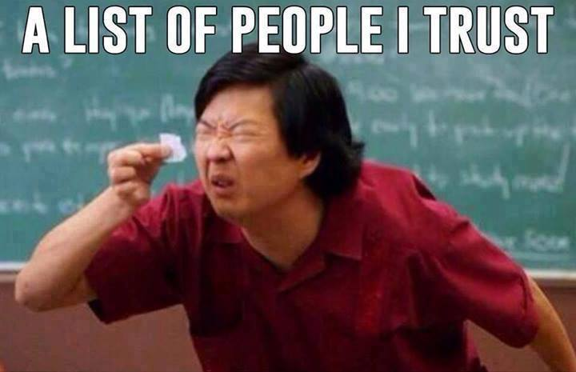

Slide 35
Building Trust: A Game!
Form pairs. First, each of you will draw a house with your eyes closed using your non-dominant hand.
Then, turn the paper over and each partner will take a turn guiding the other in drawing a house. The helper can only use words and the drawer can only follow the helper’s instructions.

Slide 36
True or False?
Substance misuse has no effect on TBI
  FALSE: > death, poorer health outcomes, ongoing disability, and non-productivity for 1+ yrs
TBI and Alcohol Use at time of injury = common
  TRUE 1/3 -1/2 intoxicated at time of injury
  ¾ has measureable amounts in body
  http://www.brainline.org/content/2009/03/substance-abuse-and-traumatic-brain-injury_pageall.html

Slide 37
True or False?
TBI is rare amongst people in SUD Treatment
  FALSE: > 38-63%
Once someone has an alcohol-related TBI, they are more careful and avoid further accidents.
  FALSE: Some evidence that the frontal cortex, often affected by TBI, may induce deficits in cognitive processing involving self-regulation and mental control, increasing risky behavior.
  http://www.brainline.org/content/2009/03/substance-abuse-and-traumatic-brain-injury_pageall.html

Slide 38
True or False
TBI is not a risk factor for developing sub use problems
  FALSE: 20% of people develop a problem
Clients with TBI may lack necessary motivation to go into SUD treatment
  True

Slide 39


Slide 40
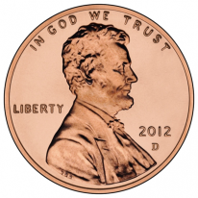
Of all substances of abuse (including cocaine, heroin, and marijuana), alcohol produces by far the most serious neurobehavioral effects in the fetus.
Alcohol = Teratogen
Stratton, Institute of Medicine,1996

Slide 41


Patrick Kennedy…
“In relation to the issue of TBI and the National Football League, the biggest source of TBI is fetal alcohol…”
From the American Society of Addiction Medicine meeting, April, 2015.

Slide 42
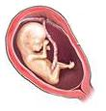
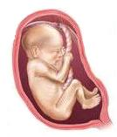
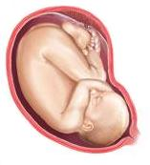
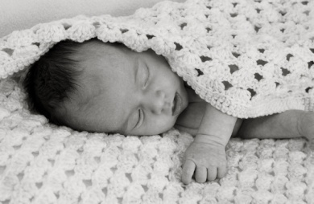
The Effects of Alcohol Consumption on a Developing Baby
Months 1, 2, & 3 | Months 4, 5, & 6 | Months 7, 8, & 9 | Birth–18 months
The major organs develop (heart, lungs, kidneys, etc.) The basic structure of brain is laid down | Body grows rapidly Movement increases | The brain grows very rapidly and organizes itself so it can work properly The lungs mature | The brain continues to grow rapidly as the baby learns new things every minute
Drinking alcohol during the first 3 months can result in problems such as heart defects and facial changes. | Drinking alcohol during the second 3 months can slow a baby’s overall growth and change the way cells in the brain develop. | Drinking alcohol during the last 3 months can greatly reduce brain growth and hurt overall brain development. | A mother who drinks alcohol while breastfeeding will pass some of that alcohol along to her baby. Babies drink less milk when there is alcohol in it.
Stopping drinking during the first 3 months can help prevent organ damage and changes to the way the face looks. | Stopping drinking now can improve a baby’s birth weight and growth and prevent the most severe effects on the brain. | Stopping drinking now can prevent the most severe effects on the brain (early in the 3rd trimester) and prepare the mother to handle the challenges of raising a child. | Stopping now means that a baby will get the nutrition that he or she needs, and a mother can be a better parent, more prepared to deal with the ups and downs of raising children.

Slide 43
Fetal Alcohol Spectrum Disorders
(FASD)
Umbrella term describing range of effects that can occur to a child whose mother drank alcohol during pregnancy
  Fetal Alcohol Syndrome (FAS)
  Neurodevelopmental Disorder associated with Prenatal Alcohol Exposure (ND-PAE, DSM-5)
  Partial FAS (pFAS)
    FASD > common than Down Syndrome
    Organic effects are not reversible
    Effects of FASD last a lifetime
    People with an FASD can grow, improve and function well in life
Notes:
FAS is the most commonly recognized term. However, it only represents one group of individuals affected by prenatal alcohol exposure.
Fetal Alcohol Syndrome (FAS): This term was first used in 1973 by Dr. David Smith and Dr. Kenneth Lyons Jones at the University of Washington to describe a small group of children who had similar patterns of facial features, growth deficiency, central nervous system dysfunction, and mothers who drank heavily during pregnancy. They remarked that these children looked as though they were related, but they were not. When this term was coined, Drs. Smith and Jones said that it was a diagnosis for two (the child and the mother). This term reflects the cause of the difficulties, rather than the symptoms.
The International Classification of Diseases (ICD) is a codebook for all medical conditions. The only specific term in the ICD related to prenatal alcohol exposure is “fetal alcohol syndrome.”

Slide 44
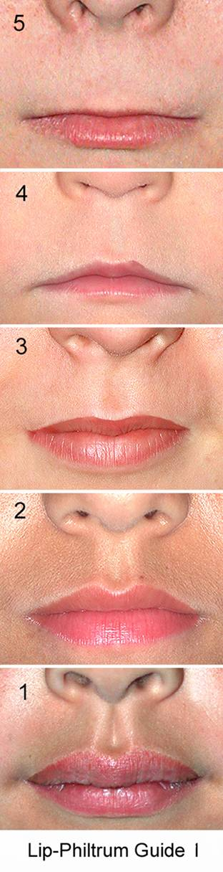
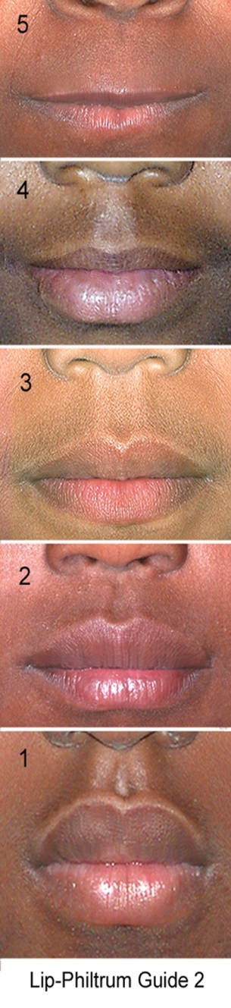
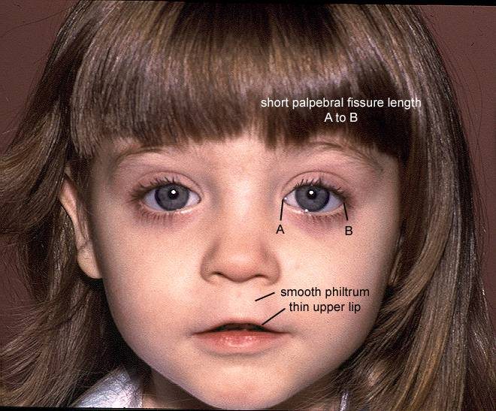
The Three FAS Facial Features
Short PFL <= -2 SD
2) Smooth Philtrum Rank 4 or 5
3) Thin Upper Lip Rank 4 or 5
FAS
S. J. Astley, PhD FAS DPN, Univ of Washington 2008

Slide 45
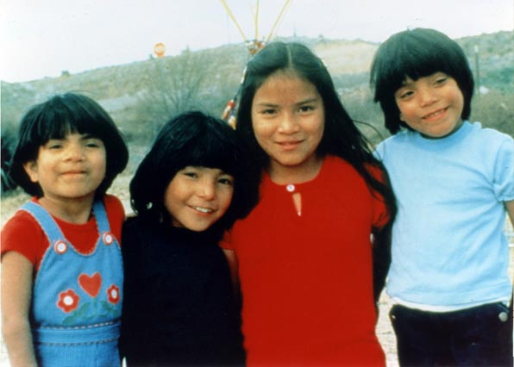
Notes:
This slide show four children born to one mother who was drinking heavily during each pregnancy. The first born, the child in the red shirt, was born with no apparent effects from her mother’s alcohol consumption. The next born child, the one in the black shirt, probably has partial FAS. The last two children both have clear FAS. This is an example of how each pregnancy can be more severely affected than the previous one, if a mother continues to drink. It also explains why women will often say something like , “Well, I have 2 kids already, I drank through those pregnancies, and those kids are just fine.” She may be right; her first two children may be fine. But it is important for her to understand that she was lucky for those first two pregnancies, and that each subsequent child being affected is higher.

Slide 46

Long flat philtrum
Thin vermilion
Stoler, 2005

Slide 47
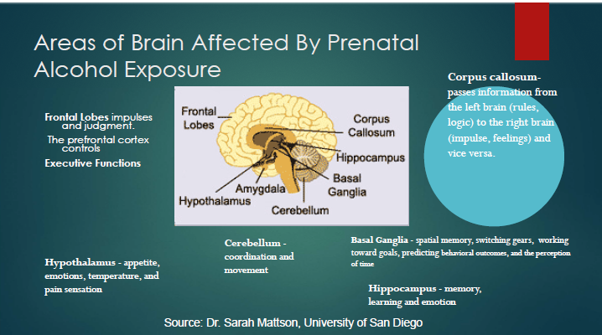

Slide 48
Areas of the Brain Damage Affected by Prenatal Alcohol Exposure
Cerebellum:
  Coordination and movement
Frontal lobes:
  Cognition and memory, ability to concentrate; judgment, inhibition
Corpus callosum:
  Connects right and left hemisphere to allow for communication between the hemispheres
  Correlation with impairment in verbal learning ability
Hippocampus and Amygdala:
  Memory
  Processing of emotional input
  Regulation of emotion and affective expression
Basal ganglia:
  Initiation and direction of voluntary movement; agitation, loss of control of emotion
Notes:
The corpus callosum connects the two hemispheres of the brain, allowing the left and right sides to communicate. Prenatal alcohol exposure can include the thinning or complete absence of the corpus callosum. These have been linked to deficits in attention, intellectual function, reading, learning, verbal memory, executive function, and psychosocial functioning. Clients with an FASD may have trouble paying attention in sessions, reading materials, remembering concepts, and applying concepts.
The hippocampus is involved in memory, but its precise function is uncertain. Alcohol can change the fibers and cause cell reduction. Some persons with prenatal alcohol exposure have deficits in spatial memory and other memory functions associated with the hippocampus. The hippocampus also acts as a mood control center. Damage to the hippocampus can affect the ability to respond appropriately to emotions, such as anger. Clients with an FASD may be prone to outbursts or other inappropriate displays of emotion.
The basal ganglia are nerve cell clusters involved in motor abilities and cognitive functions. Heavy prenatal alcohol exposure can reduce basal ganglia volume. This can affect skills related to perception, spatial memory and inhibition of inappropriate behavior. Clients with an FASD may be late to appointments, interrupt during sessions, or make inappropriate comments or gestures.
The cerebellum is involved in both motor and cognitive skills. The cerebellum tends to be smaller in people with an FASD. Damage to the cerebellum can cause learning deficits and problems with motor skills, such as balance and coordination. Clients with an FASD may be clumsy or have difficulty writing.
The frontal lobes control executive functions, such as planning and problem solving. They also control impulses and judgment. Frontal lobes can be smaller in individuals prenatally exposed to alcohol. Persons with an FASD may have poor impulse control and self-monitoring. They might engage in risky or illegal activity to fit in with peers.

Slide 49
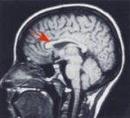
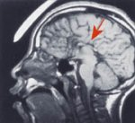
Corpus Callosum Effects
Normal
FAS
Dysgenesis of the Corpus Callosum (DCC) often result in problematic behaviors in the social/personal domains
http://www.come-over.to/FAS/corpuscompare.htm

Slide 50
FAS: Central Nervous System
  Small head circumference; below 10th percentile
  Poor fine and gross motor coordination
  Range of cognitive disabilities, including:
    Intellectual abilility
    Learning disabilities
    Intellectual disabilities
    Speech and language deficits
    Memory and processing problems
    Attention problems
Persons with neurological disorders are at increased risk for developing other neurological disorders
Notes:
Not all children with FAS or an FASD will experience all of these characteristics. Not all children with LD, ADHD, or ADD have an FASD, though most children with an FASD exhibit symptoms of these conditions. One of the few studies undertaken suggests that alcohol-affected children do not have the same neurocognitive and behavioral characteristics as children with a primary diagnoses of ADHD. See Coles et al (1997). (Enid has this article)

Slide 51
Common Comorbid MH Issues
Learning Disability
ODD
PTSD
Psychotic Disorders
Bipolar Disorder
Eating Disorders
Substance Use Disorders
ADHD
Borderline Personality Disorder
Conduct Disorder
Anxiety
Reactive Attachment Disorder
Schizophrenia
Depression

Slide 52
TNeurobehavioral features of FASD are specific
Over 60% of children with FASD are diagnosed with attention-deficit/hyperactivity disorder (ADHD)
FASD and ADHD share many behavioral features but can be distinguished using neuropsychological test data and behavior ratings
Using neuropsychological measures, we can accurately distinguish over 70%alcohol-exposed children, even when compared to children with ADHD
Notes:
A neurobehavioral profile must be both sensitive (correctly include alcohol-affected children) and specific (correctly exclude those not alcohol-affected).
Determining a profile that is sensitive is fairly straightforward in principal; it involves identifying a cognitive ability or set of abilities that are deficient in alcohol-affected persons. What is more difficult is determining whether this profile is also specific to alcohol exposure or also occurs in other developmental disorders.
As part of CIFASD, we tested whether our neuropsychological measures could be used to accurately distinguish children with FASD (without FAS) from non-exposed children with ADHD. We used an ADHD control group because of the high rates of ADHD in alcohol-exposed children. Using neurobehavioral data, our overall classification accuracy was 74%. These results tell us that we can accurately distinguish FASD from ADHD in the majority of cases, meaning that the profile is specific. But because the classification accuracy is not 100% there are still children that may be mis-identified – we need to keep working to make our profile even better.

Slide 53
Comparing ADHD, FASD &
Oppositional Defiant Disorder
FASD | ADHD | Oppositional Defiant Disorder
Doesn’t complete tasks | Doesn’t complete tasks | Doesn’t complete tasks
-may or may not take in info -cannot recall info when needed -cannot remember what to do | -takes in info -can recall info when needed -get distracted | -takes in info -can recall info when needed -choose not to do what they are told
Provide one direction at a time | Limit stimuli and provide cues | Provide positive sense of control, limits & consequences
Dubovsky, 2008 presentation

Slide 54
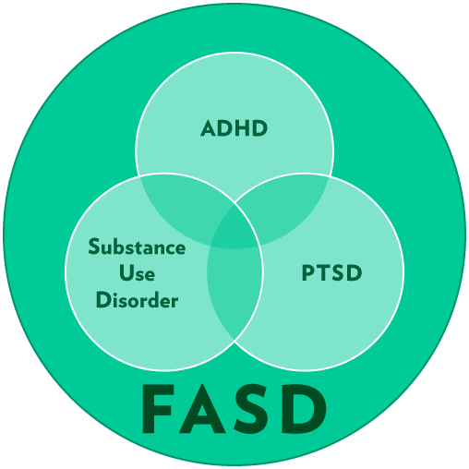
Dubovsky, 2010

Slide 55
Meet Morgan
https://www.youtube.com/watch?v=K0VrkLQfkFg

Slide 56
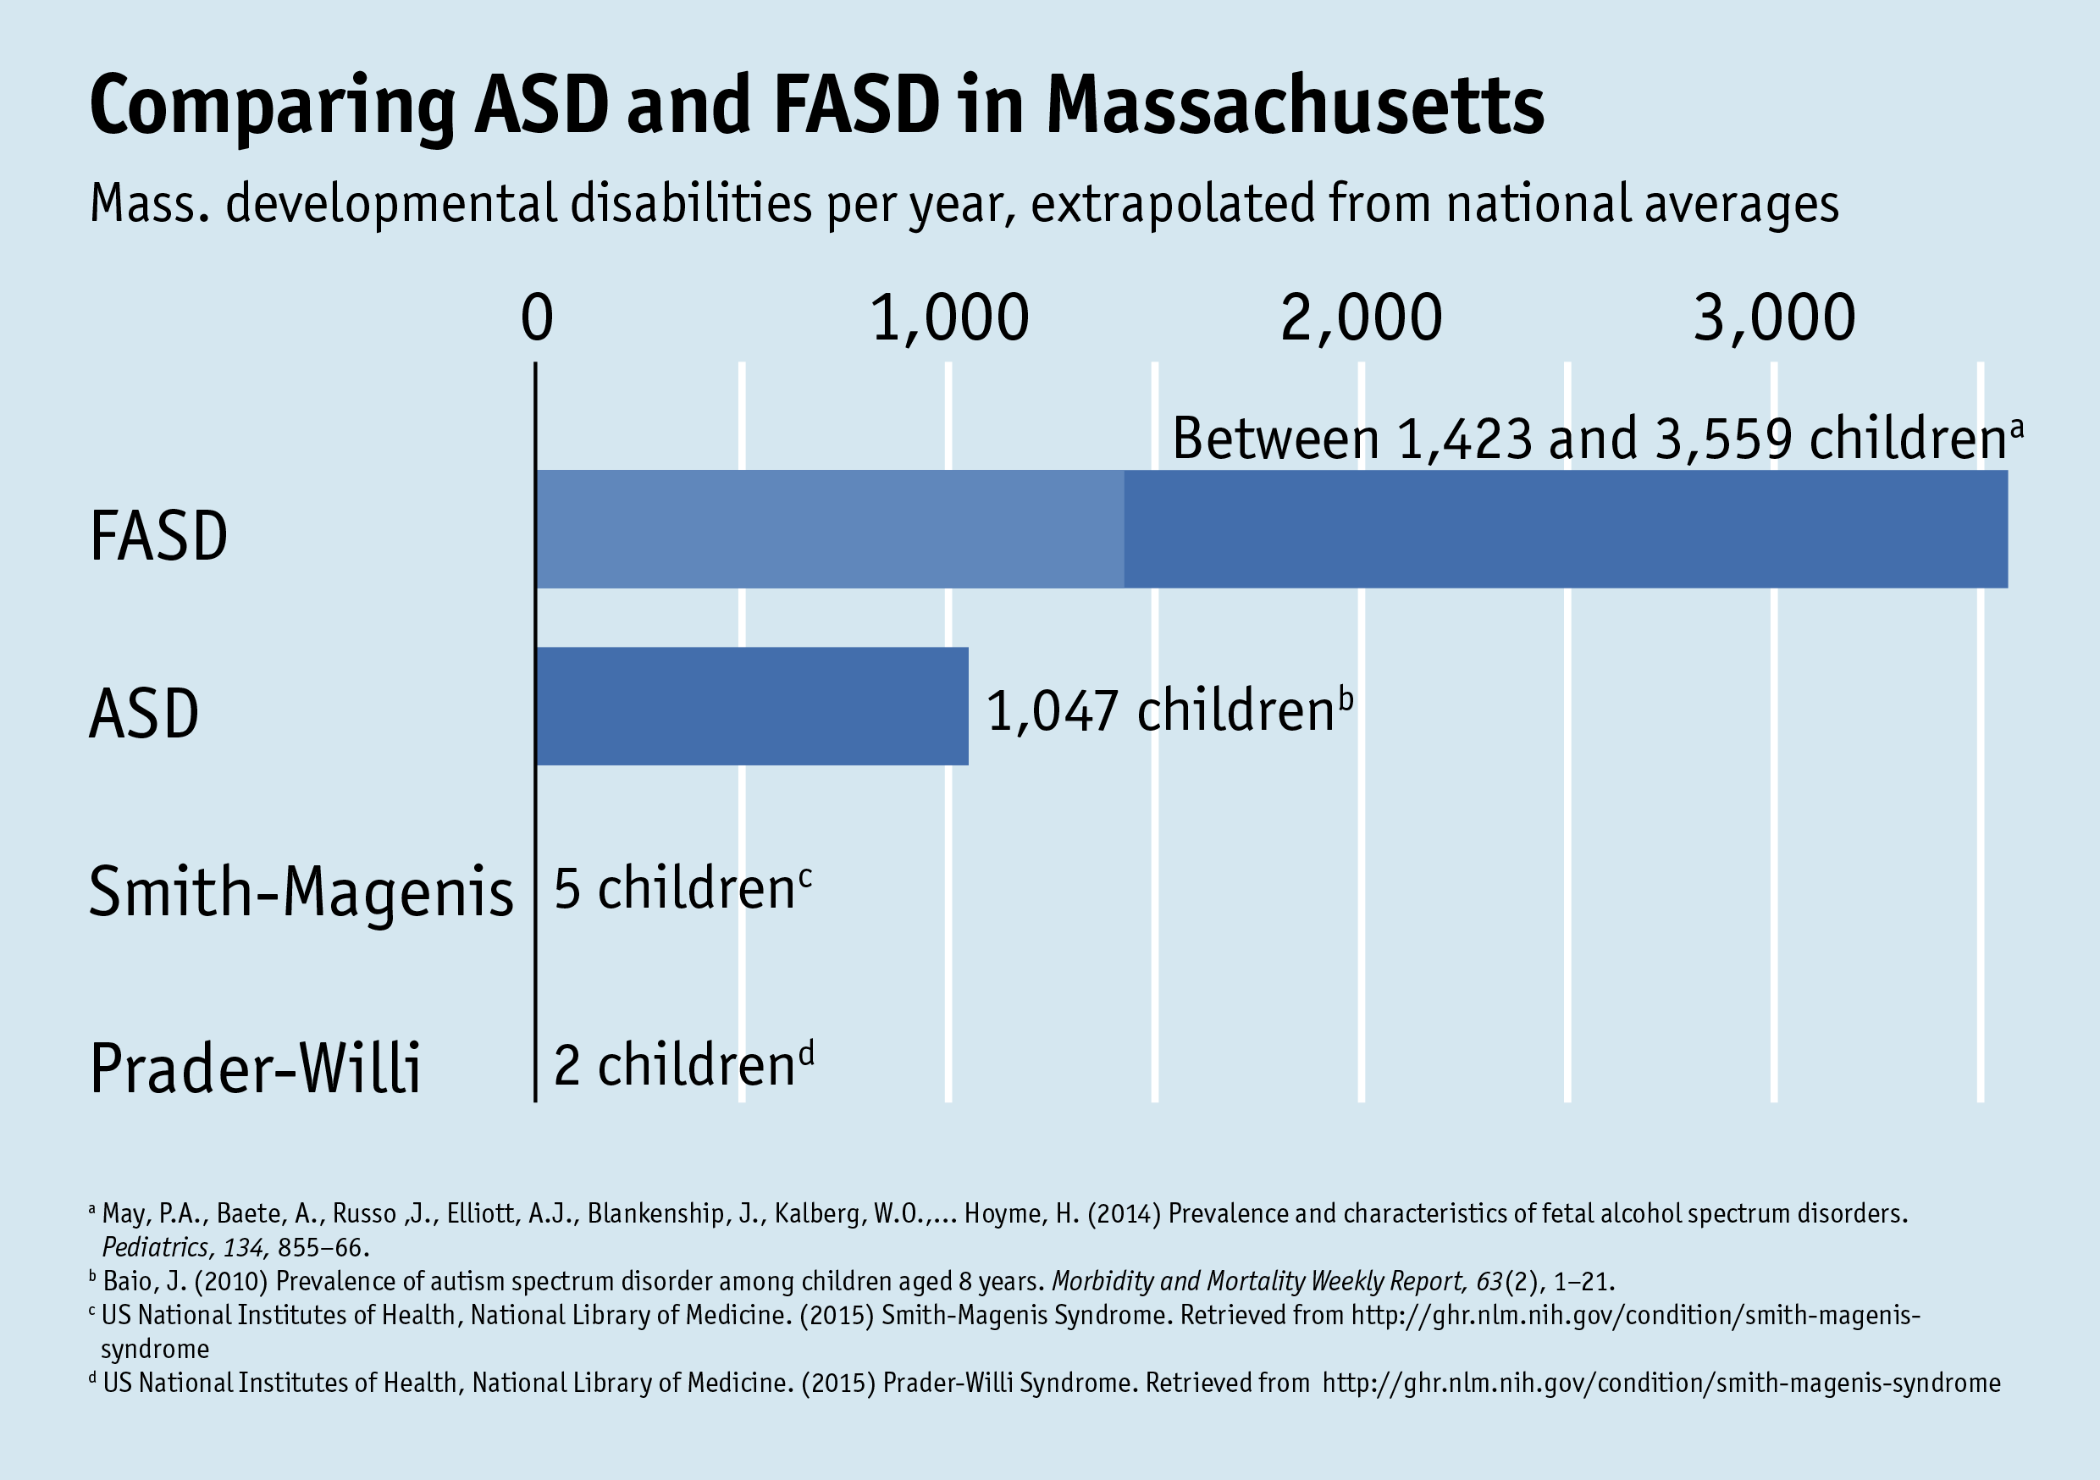

Slide 57
Missed and Mis-Diagnoses in
Foster/Adoptive Children
New study of 547 children referred for mental health assessment:
  156 children met FASD Dx criteria
  125 not previously Dx = Missed Dx of 80%
  Of remaining 31, 6.4% Dx changed w/in FASD
86.5% of youth with an FASD had not been previously diagnosed, or mis-diagnosed.
Chasnoff et al, 2015

Slide 58
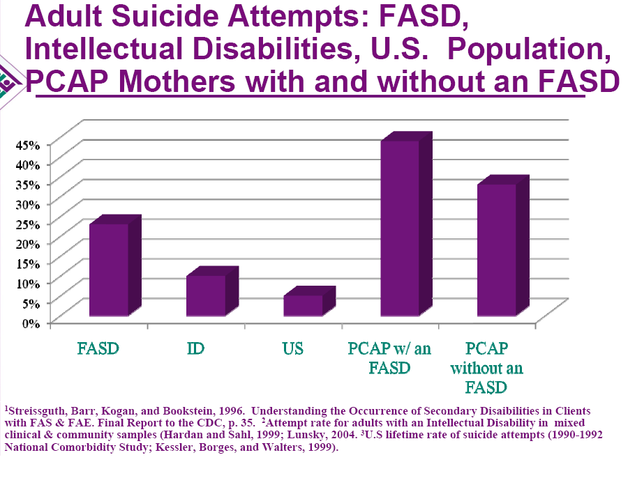

Slide 59
The Etiology of Behaviors
FASD is a physical disability: brain damage from prenatal exposure to alcohol
The effects of brain dysfunction on behaviors is typically not recognized or incorporated into interventions/treatment.
Behaviors that reflect underlying neuropathology are rarely framed in a neurological perspective and are instead viewed through a moral lens and seen as a function of volition, or psychopathology.

Slide 60
Differential Diagnoses
Genetic & Teratogenic Disorders
  Cornelia de Lange syndrome
  Dubowitz Syndrome
  Fetal Dilantin Syndrome
  Fragile X Syndrome
  Down Syndrome
  Toluene Embryopathy

Slide 61
Possible Secondary Disabilities
    School difficulties
      Academic problems
      Behavioral difficulties
      Drop-out, suspension: 60%
    Trouble with the law: 60%
    Mental health problems: 90%
    Alcohol and/or drug problems: 30%
    Multigenerational FAS Streissguth, 2004
Notes:
Having an FASD is not predictive that individuals will encounter all of these problems, though they are at risk of them without proper intervention and treatment. Ann Streissguth of the University of Washington has been a leader in the field of FASD. In a study of 415 patients with FAS, or another condition within the syndrome, she identified particular ‘adverse life outcomes’ (seen in this and following slide) that are prevalent in individuals with an FASD. See later slide on her ‘protective factors.’

Slide 62
The Invisible Disability

Slide 63
Sensory Processing Disorder & FASD
  Lack of social skills
  Auditory/vocal processing
  Visual sequencing
  Sensory integration difficulties (particularly lack of co-ordination)
  Poor retention of task instruction
  Numeracy/mathematical difficulties
  Children may benefit from an
  adapted sensory diet

Slide 64
Language Issues
Early language development may be delayed
Often verbal but w/o a lot of content
Verbal RECEPTIVE language is more impaired than verbal EXPRESSIVE language
  Talk a good game, but not able to process what they hear
  Will act on pieces of what they hear
  This is often perceived as purposeful oppositional or uncooperative behavior

Slide 65
Language & Social Deficits
  Alexithymia
  Problems in articulating emotions ≈ lack words to express feelings
  Inability to comprehend the feelings & motivations of others
  Acts out emotions in physical expression
  Misunderstood as “callous & unemotional” (appears unconcerned, without conscience or remorse, “antisocial”)
Sifneos, 1974; Coggins et al., 1998, 2008; Kapp & O’Malley, 2001; O’Malley and Nanson, 2002; Sullivan 2008

Slide 66
Literal Thinking
Clean your room
Take a shower
Wait a minute
You’re shooting yourself in the foot
Be quiet
Don’t drink and drive
See your probation officer
Follow the rules
Call with any questions

Slide 67

Verbal Receptive Language is the Basis for…
Parenting
Elementary and secondary education
Child welfare
Judicial system
Treatment: MI, CBT, DBT, Group Therapy, AA/NA
Awareness campaigns
Medical directions

Slide 68
Difficulties with Compliance
Sporadic in keeping appointments
Difficulty doing things on their own
Consistently get into difficult situations with others
Wander away, ‘fade out,’ ‘space out’
Need tremendous amount of one on one support
Limited response to punishment

Slide 69
Social Situations
Act ‘inappropriately’
Do not filter what they are saying
Say ‘rude’ things and interrupt frequently
Have difficulty with sustained relationships
May laugh at joke but take it seriously
Naïve and gullible
Easy marks for negative manipulation and abuse

Slide 70
Difficulties in School
Difficulty with math skills and abstract reasoning
Difficulty with reading comprehension
Problems following multiple directions or rules
Attention deficits
Difficulty organizing tasks and materials
Sensitivity to sensory input:
Auditory processing
Poor impulse control

Slide 71
Prevalence in Foster Care
The incidence of an FASD in foster care populations is likely much higher
  One study found that over 80% of children and adolescents with an FASD were in foster or
  adoptive homes
  It is estimated that almost 70% of children in foster care are affected by prenatal alcohol exposure in varying degrees
  Children from substance-abusing households are > likely to spend longer periods of time in foster care than other children (11 months v. 5 months)
        National Organization on Fetal Alcohol Syndrome

Slide 72
FASD and Juvenile Justice
Lack of impulse control and trouble thinking of future consequences of current behavior
Difficulty planning, connecting cause and effect, empathizing, taking responsibility, delaying gratification, or making good judgments
Tendency toward explosive episodes
Vulnerability to peer pressure (e.g., may commit a crime to please their friends)
SAMHSA FASD Center for Excellence

Slide 73
Prevalence of FASD in Criminal Justice
Adults and youth:
  estimates that 35% of individuals with an FASD have been in jail or prison at some point. They also estimate that > 60% of people with an FASD have been in trouble with the law. University of Washington
Young offenders:
  23% of youths dx with FAS remanded to forensic psychiatry assessment unit Fast et al, 1999
  24% with FASD in Canadian forensic facility Burd et al, 2004
  27% ‘at risk’ for FASD Munro et al, cited Conry et al, 2012

Slide 74
Protective Factors
Living in a stable and nurturing home > 72% of life, between 8-12 years; > 2.8 years
Diagnosis < 6 yrs. of age
No history of physical abuse
Eligibility for special services
FAS vs. other FASD conditions
Living with an alcohol abuser <30% of life
Streissguth et al, 2004
Notes:
You are all familiar with Ann Streissguth’s work on the benefit of early diagnosis.

Slide 75
Evaluation of ND-PAE
4 Domains:
NEUROCOGNITIVE
  Cognitive (IQ) & Executive Functions
Language & Social Skills
  “Social intellect” = Expressive/receptive, empathy, reciprocity, dyadic relations, semantics, nuances, V/NV cues, pragmatics)
SELF-REGULATION
  “Emotional intellect” = Mood Regulation & Autonomic Arousal
PERIPHERAL NERVOUS SYSTEM
  Multi-sensory, Motor, & Perceptual Profile
All influence Adaptive Functioning Abilities
Rich & O’Malley, 2013; Rich, 2009, 2011

Slide 76
ND-PAE
Impairment in adaptive functioning…:
  Communication deficit…
  …social communication and interaction…
  …daily living skills…
  …motor skills…
Onset of the disorder (symptoms in Criteria B, C, and D) occurs in childhood.
Clinically significant distress or impairment in social, academic, occupational, or other important areas of functioning.
Not better explained by the postnatal use of a substance, a general medical condition, other known teratogen, a genetic condition, or environmental neglect.
In “Conditions for Further Study,” Section III, Emerging Measures and Models, DSM-5, pp. 798-801.

Slide 77
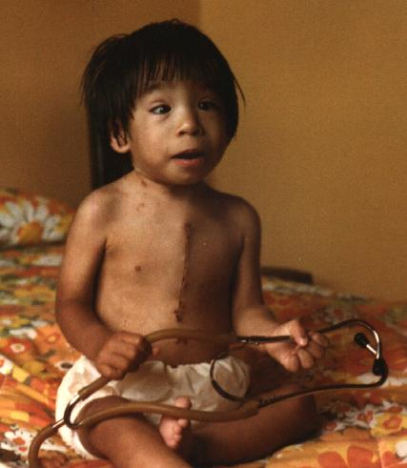
MEDICAL RED FLAGS
Cardiac defects
  VSDs, ASDs, arrhythmias
Seizure disorders
Kidney problems
Hypospadias
Cleft Lip/Palate
Pectus Excavatum
Ear Infections
Eye Surgeries
Notes:
COMMON MEDICAL PROBLEMS
in Newborns, Infants, & Toddlers w/ FASD

Slide 78
Profile of 80 Birth Mothers of Children with FAS
96% had 1-10 mental health disorders
  59% Major depressive episode
  22% Manic episode/Bipolar disorder
  7% Schizophrenia
  77% PTSD
95% physically or sexually abused
79% reported a birth parent with an alcohol problem
Astley et al, 2000

Slide 79
Neuropsych Testing Results for Alice,
22 y/o with an FASD
Full Scale IQ | 68 (i.e., low normal)
Math Calculation | 8th grade level
Reading | 4th grade level
Receptive language | 8 year-old level
Personal daily living skills | 22 year-old level

Slide 80
More Important Than IQ: Discrepancies
IQ vs. adaptive skills
IQ vs. academic achievement
Verbal IQ vs. Performance IQ
Uneven profile of cognitive abilities
Notes:
Thus, rather than IQ, discrepancies are the problem in FASD: discrepancies between IQ and adaptive skills, between IQ and achievement, and even between skill levels on the IQ test. I frequently see significant splits between Verbal and Performance IQs where the individual is able to communicate and sound “normal” in a conversation but is significantly impaired in terms of his ability to reason and use good judgment.

Slide 81
Resources
SAMHSA FASD Center for Excellence: fasdcenter.samhsa.gov
Centers for Disease Control and Prevention FAS Prevention Team: www.cdc.gov/ncbddd/fas
National Institute on Alcohol Abuse and Alcoholism (NIAAA): www.niaaa.nih.gov/
National Organization on Fetal Alcohol Syndrome (NOFAS): www.nofas.org
Notes:
Further information is available through the FASD Center’s Information Resource Center, 1-866-STOPFAS (786-7327) or fasdcenter@samhsa.gov. In addition, users may request training from the FASD Center by contacting the Information Resource Center or completing the the online form at fasdcenter.samhsa.gov/resource/ta/trainingassistance.cfm.

Slide 82
Trauma-Informed Approach
to Alcohol and Other Drug Screening
Using alcohol and other drug can affect one’s health and safety, as well as how one makes decisions and does in life. Therefore, we ask all clients questions about their use of these substances. By alcohol, we mean beer, wine, wine coolers, or liquor.
By drugs we mean anything that one might use for the feeling it causes including marijuana, cocaine, crystal meth, oxycontin, heroin, etc
All of your answers are strictly confidential, unless you or someone else is in imminent danger.
Is it OK to ask you these questions?

Slide 83
Pre-Screen Questions
How many times in the past year did you
  drink any alcohol? ____
  smoke any marijuana? ____
  use anything else to get high? ____
  (“Anything else” includes illegal drugs, over the counter and prescription drugs, and things that you sniff or “huff”.)
If all answers are “NO”, Ask CAR question only, then stop.

Slide 84
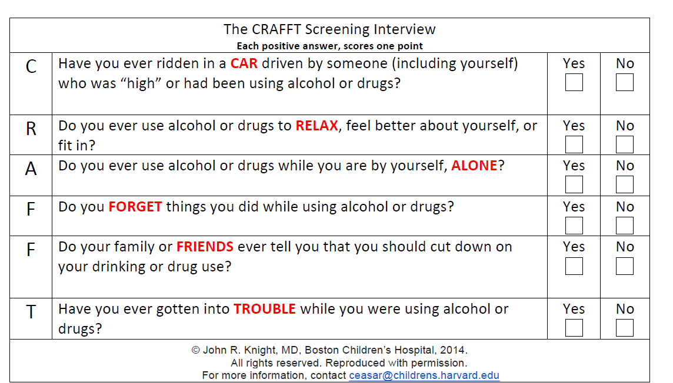
During the PAST 12 MONTHS

Slide 85
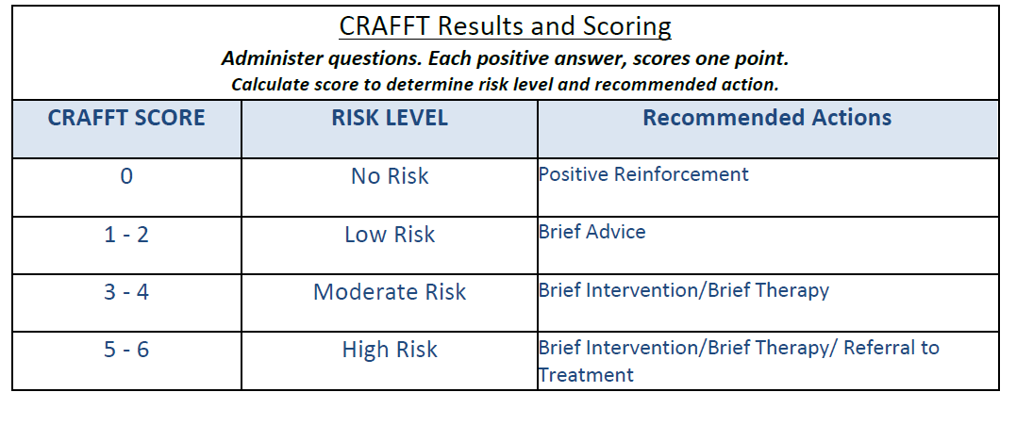

Slide 86

Interventions

Slide 87
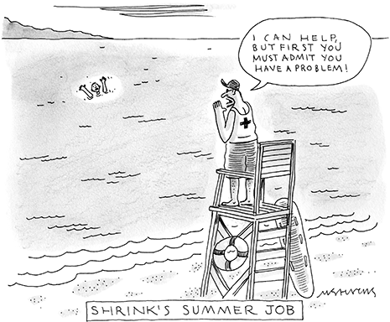

Slide 88
Motivational Interviewing….
…was developed from the rather simple notion that the way people are spoken to about changing addictive behavior affects their willingness to talk freely about why and how they might change.
Stephen Rollnick, PhD Addiction 2001; 96:1769-70.

Slide 89
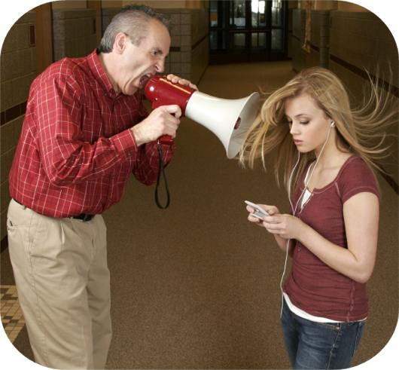

Slide 90
Take Home Message:
Change Comes from Within
Take Home Message:
Change Comes From Within
When people can voice their own reasons for change aloud, they are more likely to make the change.

Slide 91
The MI Spirit
People are competent
We assume that they have self-knowledge, attitudes, and capabilities that can effect change
Our main focus is on being present in a way that supports change

Slide 92
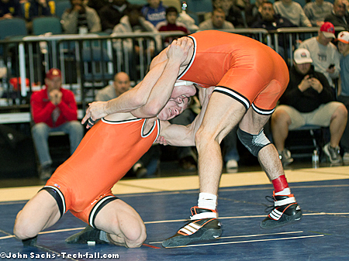
MOTIVATIONAL INTERVIEWING
....NOT

Slide 93
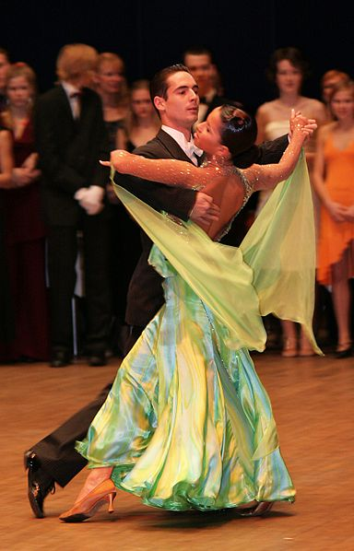

Slide 94

Describe students like Bob:

Slide 95

Ask Permission
Unsolicited advice is the junk mail of life.
Bern Williams

Slide 96
What people
really need
is a
good listening to.
Mary Lou Casey

Slide 97

Ambivalence Precedes Change

Slide 98


Slide 99
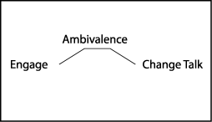
Behavior
Change
Steps to Change

Slide 100
OARS
  Open-Ended Questions
  Affirming
  Reflective (Active) Listening
  Summarizing
Elicit Positive “Change Talk”
100
Notes:
100

Slide 101

OARs: Open-Ended Questions
CLOSED
Are you worried about your current situation?
Have you noticed changes?
Do you care about your health?
OPEN
What worries you most about your current situation?
What changes have you noticed?
How so?
Notes:
How we ask questions affects the conversation. An example of a closed…and open…
Why would you want to use an open question over a closed question?

Slide 102
OARS
OARS
  Open-Ended Questions
  Affirming
  Reflective (Active) Listening
  Summarizing
Elicit Positive “Change Talk”
102
Notes:
102

Slide 103
OARS: Open-Ended Questions
Do you want to graduate from school or not?
How are you feeling about school? What do you like about school? What do you like less? What are your plans for next year?
Are you taking your medication regularly?
How are you doing with taking the medication?
Have you been smoking marijuana?
What are your thoughts about smoking marijuana?
Where are you at with smoking marijuana?
Do you think you are having a problem?
How do you see your drinking?
Did you party over the weekend?
How did you spend your weekend?

Slide 104
Guidelines with Questions
Ask fewer!
Avoid more than 3 in a row
Ask more OPEN than closed questions

Slide 105

OARS: Affirmations*
* accurate

Slide 106

OARS: Affirmations
Statements and gestures that recognize strengths and acknowledge behaviors that lead in the direction of positive change
  I am really impressed with the way you….
  That’s great how you’ve cut class only once this week.
  Your willingness to talk about your homework situation tells me that you care about…
Be genuine and specific
  Only say it when you really mean it.

Slide 107
Build on Strengths
Build on Strengths
“Let’s think through last week. Can you tell me what you did that helped you get closer to achieving your goal, even if you did not achieve your goal?”
Notes:
Think of one to three things that you did yesterday (or last week) that got you closer to your goal, and you can include any thoughts or planning that probably helped.

Slide 108
AFFIRM
Take the time to identify the value in what the student says
Build an alliance with the student
Be genuine

Slide 109
Practice
“This is tough, I’ve got stress coming at me from all angles. I want to stop drinking but don’t really know how.”
MI tool: Affirm

Slide 110
OARS: Reflective Listening
What people
really need
is a
good listening to.
Mary Lou Casey

Slide 111
Reflective (Active) Listening
COMPLEX
Goes beyond
what they said
Hypothesis (guess) to capture what student meant
Intonation down (statement; not question)
Deepens understanding
Forward movement

Slide 112
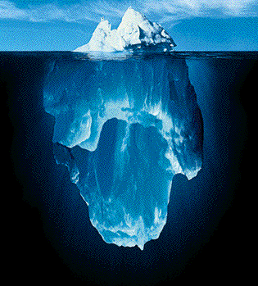
Simple v. Complex Reflections
Simple Reflection
Complex Reflection

Slide 113
Video
https://www.youtube.com/watch?v=-4EDhdAHrOg
https://www.google.com/search?hl=en&gl=us&tbm=&authuser=0&q=everybody+loves+raymond+active+listening&oq=everybody+loves+raymond+active+listening&gs_l=news-cc.1.1.43j43i53.2258.12878.0.14755.44.23.2.19.18.0.67.1325.23.23.0...0.0...1ac.1.dW4kxFmauAY

Slide 114

But

Slide 115
“I only drink on the week-ends.”
Simple Reflection: “You only drink on the week-ends.
Complex Reflection: “You only drink on the week-ends. You know that drinking during the week can interfere with your school work.”

Slide 116
Read the Sentence Stem…Group Answers
It’s been fun, but something has got to give. I just can’t go on like this anymore.
Simple:
Complex:
It’s been over a year since I haven’t missed a day at school.
Simple:
Complex:
Ex. 6
Notes:
Have people call out answers to this on first page. Second page, everyone writes their own.

Slide 117
Sentence Stems
You know if she would just back off, then the situation would be a whole lot less tense and then these things wouldn’t happen.
Simple:
Complex:
I’ve been depressed lately. I keep trying things to help me feel better but nothing seems to work.
Simple:
Complex:
Notes:
This page, everyone writes their own answers.

Slide 118
    “There’s nothing wrong with smoking a little weed now and then. It’s a natural product. Everyone I know smokes.”

Slide 119
“I’m not sure what I’ll do. I really like drinking, but it’s becoming a hassle now.”

Slide 120
    “There’s nothing wrong with smoking a little weed now and then. It’s a natural product. Everyone I know smokes.”

Slide 121
OARS Summarize
Hypothesize with client“Let’s see if I have this right…”
    “So it sounds to me as if…”
Accomplish 2 goals:
    Client knows you are genuinely interested in what they are saying
    Give yourself a chance to get the facts straight!
The Art of Active Listening. (2005). National Aging Information & Referral Support Center, Washington D.C.

Slide 122
Elicit response:
  “How does all this sound to you?” “Where do we go from here?”
Negotiate a goal:
  “What would you like to do?”
Summarize:
“This is what I heard you say.”
Offer a Menu of Options:
“If you like, I can tell you what some people in a similar situation have found helpful.”
Notes:
122
122
122

Slide 123
OARS Exercise: Think of a Change…
    Open ended question
    Affirmation:
    Reflection:
    Summary:

Slide 124
Stages of Change
Precontemplation
Contemplation
Preparation
Relapse
Action
Maintenance

Slide 125
Seeing things differently
From Seeing | To Understanding
Won’t | Can’t
Lazy | Tries hard
Lies | Fills in
Doesn’t try | Exhausted or can’t start
Doesn’t care | Can’t show feelings
Refuses to sit still | Over-stimulated
Fussy, demanding | Over-sensitive
Resisting | Doesn’t ‘get’ it

Slide 127
Behavioral Interventions
Identify triggers
Modify the environment
Alter responses to behaviors
Notes:
The most effective behavioral interventions to date have worked on modifying the home and school environment so that situations which can trigger conduct problems are reduced, as are the caregiver responses to such responses.

Slide 128
Adapting Treatment
Ask clients to use colors or animals to describe their feelings if it is hard for them to use ‘feeling’ words
Place photos of counselors on their office doors
Use concrete representations, i.e.
  Big blue beach ball to represent guilt clients carry
  Strands of wool laid out on floor to represent boundaries

Slide 129
Paradigm Shift
Change the definition of success
“We must move from viewing the individual as failing if s/he does not do well in a program to viewing the program as not providing what the individual needs in order to succeed.”
Dubovsky, 2000

Slide 130
Strategies
Individual support
Peer support
Art therapy
Allow histories to be told out of sequence

Slide 131
Strategies
Avoid confrontation, which can provoke or agitate brain-injured clients
Remember that inappropriate behavior may be unintentional
Assist clients in adopting assistive technologies such as cell phones, smart phones, personal digital assistants, etc. Help them set up reminders for medications, appts, etc.

Slide 132
A Strength-Based Approach to Improving Outcomes
Identify strengths in client (family, community)
  What do they do well? Like to do? Best qualities?
  Common strengths in persons with an FASD :
    + Friendly + Hard Worker
    + Likeable + Determined
    + Verbal + Good with younger children
    + Helpful with supervision
    + Caring + Not malicious
EVERY DAY IS A NEW DAY

Slide 133
Modifying MI for Individuals with
Cognitive Challenges
Ask, “What are the good things and the less good things about this behavior or action?”
  Write it down
  Be thorough
  Ask, “What else is good about it?”
Use lots of repetition and review
Use multiple senses (videos, computer)
Do the work IN the meeting instead of homework

Slide 134
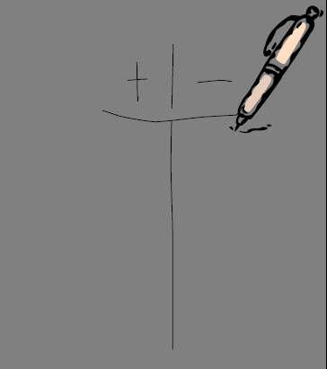
Good and Not So Good Things

Slide 135


What Helps? What Doesn’t Help?

Slide 136

Cognitive/educational interventions
Cognitive control therapy:
  “When I get frustrated, I stop and
  take a deep breath.”
  “If I feel angry, I can say that I am angry.”
  “If someone makes me mad, I can turn around and walk away.”
  “When I feel out of control, I ask for help.”
Notes:
The greatest amount of intervention research has focused on academic support. These studies have demonstrated not only that children with FASD can be successful learners, but that a relatively small amount of targeted support (1-2 hours a week) made dramatic improvements. Some of these improvements may be due to teaching occurring in an optimized learning situation (1 on 1 teaching), where distractions can be minimized and errors corrected quickly. Some studies have used computer programs which optimize both attention and quick, objective feedback. These studies also demonstrate that simple changes can have big impacts. For example, a study recently reported out of Carnegie Mellon showed that the wildly decorated classrooms so commonly found in U.S. elementary schools may be overly distracting to all students, and that plainer walls may allow better focus and learning. Such simple interventions can have important benefits for those with FASD.

Slide 137
Adaptive Interventions
Change presenting problem behavior.
Change caregiver understanding of client’s behavioral problems differently and provide accommodations in all settings.
Notes:
Many children with FASD are socially awkward, even as they appear socially pleasant and chatty. They may be operating at a social level several years younger than their chronological age, and yet desperately want and need friends. They have trouble reading social cues, may be rejected by age-mates, or fall prey to those are see their naievety and are willing to take advantage of it. They also tend to be very concrete learners, having difficulty translating what they have learned in one context to another. These challenges impact both emotional health/growth and safety. Specific interventions which focus on teaching the skills that come so naturally to others has been shown to improve behavior and to demonstrate skills in real-life situations.

Slide 138
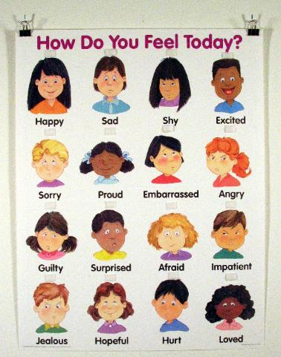
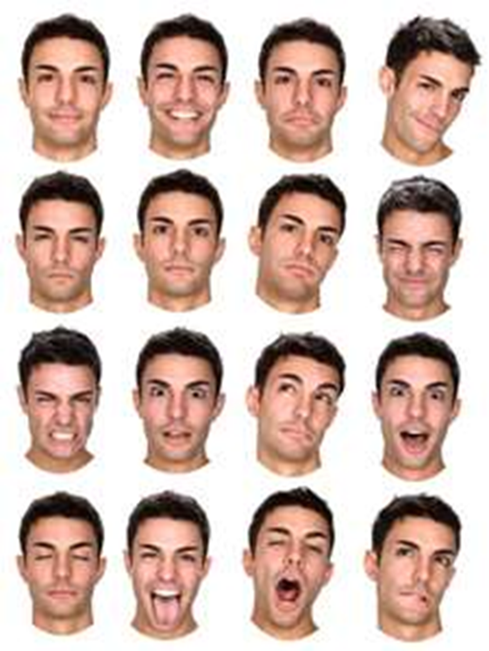

Adaptive Interventions
Social skills training
Safety skills
Contraception
Notes:
Many children with FASD are socially awkward, even as they appear socially pleasant and chatty. They may be operating at a social level several years younger than their chronological age, and yet desperately want and need friends. They have trouble reading social cues, may be rejected by age-mates, or fall prey to those are see their naievety and are willing to take advantage of it. They also tend to be very concrete learners, having difficulty translating what they have learned in one context to another. These challenges impact both emotional health/growth and safety. Specific interventions which focus on teaching the skills that come so naturally to others has been shown to improve behavior and to demonstrate skills in real-life situations.

Slide 139
A Strengths Based Approach to people with an FASD/TBImproving Outcomes
Identify strengths and desires in the individual
  What do they do well?
  What do they like to do?
  What are their best qualities?
  What are your funniest experiences with them?
Identify strengths in the family
Identify strengths in the providers
Identify strengths in the community
  Include cultural strengths in the community

Slide 140
Strategies for Improving Outcomes for Individuals With an FASD
Simplify the individual’s environment
  Simplify routines
  Simplify the person’s room
  Be consistent in activities and times
Use a lot of repetition
Provide one direction or rule at a time
  Review directions and rules regularly
  Check for true understanding
  Talk about how to help the person follow the direction or rule

Slide 141
Strategies for Improving Outcomes for Individuals With an FASD/TBI
Identify strengths in the individual, family and providers
Provide a mentor
Softer lighting, softer colors, softer sounds
Utilize positive reinforcement systems rather than reward and consequence systems
  Don’t start sentences with “if”
Use short term consequences
Do not use natural consequences
  Especially if they put the person at risk
Use repeated role playing, preferably with videotaping

Slide 142
Strategies for Improving Outcomes for
Individuals With an FASD
Be aware of, and discuss, misinterpretations of words or actions of others when they occur
Find something that the person likes to do and does well (that is safe and legal) and arrange to have the person do that regardless of behavior
Whenever you want to say “you can’t” you have to also say “you can”

Slide 143
Strategies for Improving Outcomes for
Individuals With an FASD/TBI
Identify two things that helps the person calm down when they are upset
Work on identifying when the person begins to get stressed, anxious, or frustrated and intervene immediately
Create “chill out” spaces in each setting
Use literal language
Use person first language

Slide 144
Use Literal Language
Don’t drink and drive…
Do not use metaphors or similes
Do not use idiomatic expressions and proverbs
  A little bird told me
  People in glass houses shouldn’t throw stones
  He’s a sitting duck
  I’m all ears
Don’t use sarcasm
Be careful about joking with the person
Think about how what you say could be misinterpreted

Slide 145
Person First Language
“He’s a child with FAS” not “he’s an FAS kid”
A person affected by prenatal alcohol exposure, not “the affected person”
A mother with FAS, not “an FAS mom”
“She has an intellectual disability” not “she is mentally retarded”
“He has a mental illness” not “he is mentally ill”
“He has schizophrenia” not “he is a schizophrenic”
No one “is” TBI,although a person may have TBI

Slide 146
Selected Recovery Supports
SMART recovery
  Enhancing and maintaining motivation
  Coping with urges
  Problem-solving
  Lifestyle balance
12-Step (many varieties)
  Alcoholics Anonymous
  Narcotics Anonymous

Slide 147
Provide concrete examples of AA
Share AA literature, big book, the story of Bill W
Show a movie or TV depiction of an AA movie e.g. Clean and Sober or...
My Name is Bill W. a 1989 movie with James Gardner and James Wood
Scene from last season of HBO’s The Wire depicting a 12 step meeting
Ask a consumer in recovery to come and speak to group/individual

Slide 148
For Individuals with Severe Brain Injury Provide concrete examples of AA
Convert the 12 steps into pictures
Can be a group activity or individual activity
Good for individuals with impaired language skills/concrete thinkers
(Reynolds and Murrey 2006)

Slide 149
More Tips for 12 Step Meetings
Attend 12-Step meetings with a “buddy” or staff member, review meeting highlights
“90 meetings in 90 days” may be too stimulating or fatiguing after a TBI, balance so benefits of structure & social group can be gained
If the individual plans to share at a meeting, have them jot down before hand what they want to say on an index card

Slide 150
More Tips…
Avoid approaches that are confrontational (Sparadeo, NASHIA Webcast 2003)
Insight oriented treatment approaches may not work for folks w TBI
Offer “The Big Book” and other books with a recovery or inspirational theme on tape
“One day at a time”

Slide 151
Use “Change Plan” & “Staying Clean, Staying Sober” Worksheets
Prepare for slip ups-”Emergency Plan”& “Personal Emergency Plan: Lapse”
Judicious use of drug testing

Slide 152
Feedback from Individuals in Recovery
The researchers at the Research and Training Center on Community Integration of Individuals with Traumatic Brain Injury at Mt. Sinai in New York asked individuals with TBI, what are the factors involved in “kicking the habit”

Slide 153
What They said…..
Early treatment for those identified as known substance abusers
Pay attention to the covert drug users
Challenge of redefining new self and life doubled with TBI sequela and substance abuse issues
Hard to know where to find support, with TBI community or substance abuse community

Slide 154
What They said…..
To stay clean:
find the right 12-step program,
change “persons, places and things” that trigger use,
spirituality…..,

Slide 155
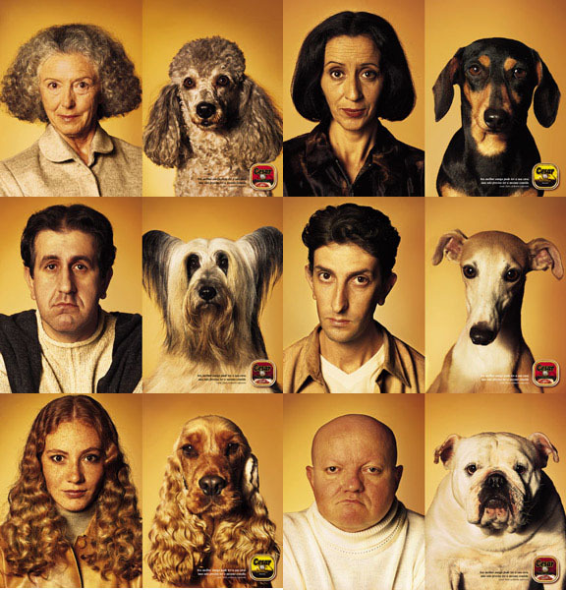

Slide 156
Never underestimate the value the participants place on your opinions and advice
You don’t have to be an Addictions Counselor to speak from your knowledge and expertise regarding the impact of substances on the rehabilitation work you are doing with someone e.g….
“As your ___________, I need to let you know that drinking will impact your balance and we want to do all we can to minimize the risk of fall”
“As your ____________, I recommend you do not drink alcohol because it will make your articulation, memory and new learning abilities worse”

Slide 157
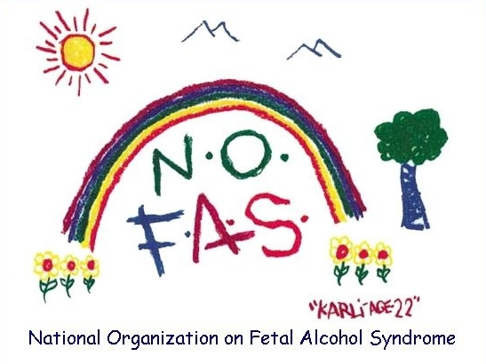
The 12 Steps Revisited for Individuals with FASD and Their Families
Kathleen Tavenner Mitchell, MHS, LCADC
Vice President and National Spokesperson
National Organization on Fetal Alcohol Syndrome

Slide 158
Disclaimer:
I do not speak for-nor represent AA, NA, Al-anon, or the Twelve Steps of AA
Intent is to review the 12 steps in a way that might be helpful for families that are dealing with both FASD and possibly addiction, and to investigate a way of life that has helped millions live life one day at a time, happy, joyous, and free!

Slide 159
The Twelve Steps of Alcoholics Anonymous
1. We admitted we were powerless over alcohol - that our lives had become unmanageable.
2. Came to believe that a Power greater than ourselves could restore us to sanity.
3. Made a decision to turn our will and our lives over to the care of God as we understood Him.
4. Made a searching and fearless moral inventory of ourselves.
5. Admitted to God, to ourselves and to another human being the exact nature of our wrongs.
6. Were entirely ready to have God remove all these defects of character.

Slide 160
7. Humbly asked God to remove our shortcomings.
8. Made a list of all persons we had harmed, and became willing to make amends to them all.
9. Made direct amends to such people wherever possible, except when to do so would injure them or others.
10. Continued to take personal inventory and when we were wrong promptly admitted it.
11. Sought through prayer and meditation to improve our conscious contact with God as we understood Him, praying only for knowledge of His will for us and the power to carry that out.
12. Having had a spiritual awakening as the result of these steps, we tried to carry this message to alcoholics and to practice these principles in all our affairs.

Slide 161
12 Step Recovery for individuals with an FASD:
Hand select the sponsor (s)
Weekly routine of meetings
Home group
Transportation available through intergroup networks
Sober housing
Sober activities-get involved
Service work

Slide 162
AA Slogans…but will they work?
One Day at a Time (Just for Today)
Let Go & Let God
Live & Let Live
To Thine Own Self be True
We can Start our Day Over at Anytime
Misery is an Option
Easy does it
Keep it Simple (KISS)
Think, Think, Think it Through

Slide 163
STEP ONE: I CAN’T
    “When I drink, I always end up in jail.”
    Do you like jail?
    “No”
    Then how do you keep out of jail?
    “Don’t drink any alcohol.”
    One Drink + More Drink = JAIL
163

Slide 164
Consequences (help to identify what’s changed)
My friends-family
Hobbies
Police
My health
Depression
My church, synagogue
School
Accidents
Loss of goals
Money problems
Abusive relationships
Destructive behavior-hurt self or others/animals (cutting, slapping, hitting)
Suicide-Homicidal thoughts

Slide 165
God grant me the serenity
Step 2
To accept the things I cannot change, the courage to change the things I can, and the wisdom to know the difference.

Slide 166
Step 2: GOD
God can do for us, what we cannot do for ourselves
GOD = GROUP of DRUNKS
  You are Not Alone
GOD = Good Orderly Direction
  Just ask for help

Slide 167
Gentleness
Homework:
  Walk with a friend
  Pick flowers for your home
  Call an old friend
  Watch a favorite movie
  Tale a bubble bath
  Doodle/color
  Read a favorite magazine/book
  Garden
  Buy a new app
  Play a favorite video-game
  Listen to a favorite song
  Dance
  Watch the sun set
  Draw/paint/create

Slide 168

Step 3 Turn it Over
    Practice prayer
      Give it to God

Slide 169
STEP 4 Made a searching & fearless moral inventory of ourselves.
“I lied, I cheated, I stole…”
Sponsor-directed
Secrets will keep me sick-write them
  Who makes me angry?
  List of things I don’t like about myself
  Stuff I’ve done that make me upset
  Okay to draw, use bulleted notes, or tape recorder
List of things I like about myself-things I’m really good at…

Slide 170
Step 5 Tell someone about the things I do not like about myself list
Sponsor, minister, rabbi, trusted friend, counselor
Concrete directions
  Top 10 secrets, top 10 people I am angry at, top 10 behaviors I do not like, top 10 things about me that I like
  Include person in a ritual to finalize (burn the list, rip the list, bury the list).

Slide 171
Step 7 Humbly ask God/HP to remove behaviors that make you sad, feel bad, or hurt.
Ask for help: ask…
I am now willing to change.
I am sick & tired of being sick & tired!
I too, deserve to be HAPPY!

Slide 172
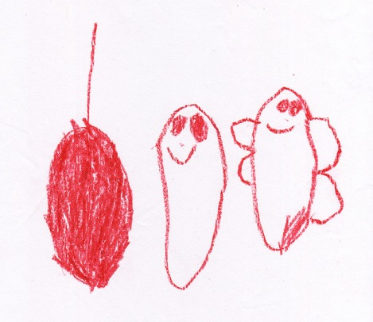
Step 8 Make a list of all persons we had harmed and became willing to make amends to them all.
I wish I did not hurt people and I want to say that I’m sorry.
Assist them; list family members first.
List secondary people.
Transformation step – Cocoon to Butterfly

Slide 173
Step 9
Make direct amends to such people whenever possible, except when to do so would injure them or others.
I’m sorry….
I am now doing what I need to do to change.
Sponsor assisted !

Slide 174
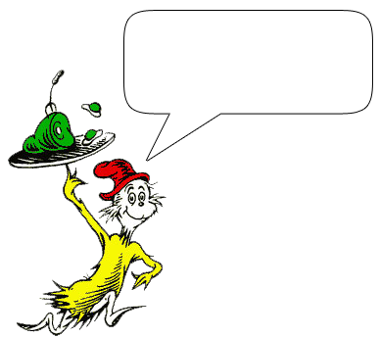
Step 9 according to Dr. Seuss
Bartholomew and the Oobleck …I am sorry.

Slide 175
Step 10 Continued to take personal inventory and when we were wrong promptly admitted it.
Self Awareness:
I make mistakes. I apologize when I know that I made a mistake.
What keeps you up at night…you make to make right.

Slide 176
Step 11…
Develop Spiritual Habits:
Practice prayer-talk to God/HP
Walk in nature-daily
Write a letter to your HP-concrete actions to feel spiritual connection
Practice meditation-listen to God/HP
  meetings, church, nature, meditation, friends

Slide 177
Affirmations (paste them everywhere!)
I am not my FASD/TBI, nor am I my addiction
I choose not to live in blame
I am perfect just as I am today
I accept that I have struggles, I am not a victim to them
God does not make junk
I am right where I am supposed to be
I am loved and I am lovable

Slide 178
God as we understood Him
No one is gonna tell you who God is
Who is God to you?
Each person has their own relationship with God
Whatever works

Slide 179
        Step Twelve
Having had a spiritual awakening as a result of these steps, we tried to carry this message to alcoholics, and to practice these steps in all of our affairs.
Spiritual Awakening?
  I care about me…I do count!
  I care about my family
  I care about my dog

Slide 180
As a result of these steps, I now care about myself and others…
I got a service position
I go to dances and fun events
I share in meetings
I am kind to my parents
When I am wrong and I know it, I apologize
  It’s working!

Slide 181
The Twelve Promises of A.A.
1. We will attain and maintain sobriety.
2. We are going to know a new freedom and a new happiness.
3. We will not regret the past nor wish to shut the door on it.
4. We will comprehend the word “serenity” and we will know peace.
5. No matter how far down the scale we have gone, we will see how our experiences can benefit others.
6. The feeling of uselessness and self-pity will disappear.

Slide 182
The Twelve Promises of A.A.
7. We will lose interest in selfish things and gain interest in our fellows.
8. Self-seeking will slip away.
9. Our whole attitude and outlook on life will change.
10. Fear of people and economic insecurity will leave us.
11. We will intuitively know how to handle situations which used to baffle us.
12. We will suddenly realize that God is doing for us what we could not do for ourselves.

Slide 183

A journey of a thousand miles begins with a single step.
-Lao Tzu

Slide 184

Be Strengths-Based

Slide 185



Final Thoughts to Keep in Mind

Slide 186

FASD is 100% Preventable
Leading known cause of preventable, non-genetic intellectual disabilities
Caused solely by alcohol consumption by pregnant women
Notes:
Alcohol consumption by the biologic father does not contribute to FASD. FASD results in approximately 2-4% of all mental retardation (Georgia/CDC and Sweden studies). We only know what causes about 20% of mental retardation.

Slide 187
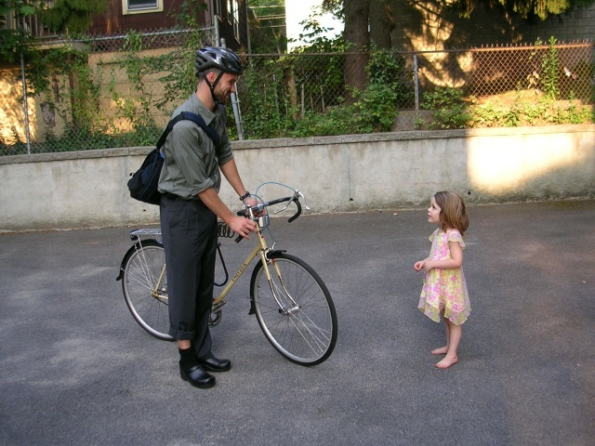
Thank You!

