Slide 1
Department of Developmental Services Massachusetts
HCSIS
(Home and Community Based Services Information System)
Incident Management Module Training ASD Children Waiver Population
June 2021
1

Slide 2
Objective and Agenda
Objectives:
Overview of HCSIS
Explain Incident Management Functionality in HCSIS
Agenda
HCSIS Overview
HCSIS as an Incident Management System
Incident Management Responsibilities and Roles
Incident Report Submission and Review Timeline
Incident Report Components and Submission Process
Incident Categorization
Incident Category Guidelines
Clinical Manager Review
DDS Follow Up Action Steps document
Process Management Screens and Management Reports
2

Slide 3
HCSIS
(Home and Community Based Services
Information System)
Overview

Slide 4
Virtual Gateway
The Commonwealth Virtual Gateway is a central portal for accessing programs and services offered by the Executive Office of Health and Human Services (EOHHS). It can be accessed through the mass.gov website.
HCSIS is a web-based Quality Management and Service Planning system that uses the Virtual Gateway is to streamline service access and coordinate service delivery via clear communication channels. It serves three important groups:
Individuals
Service Providers
Internal Health and Human Services (HHS) state staff
4

Slide 5
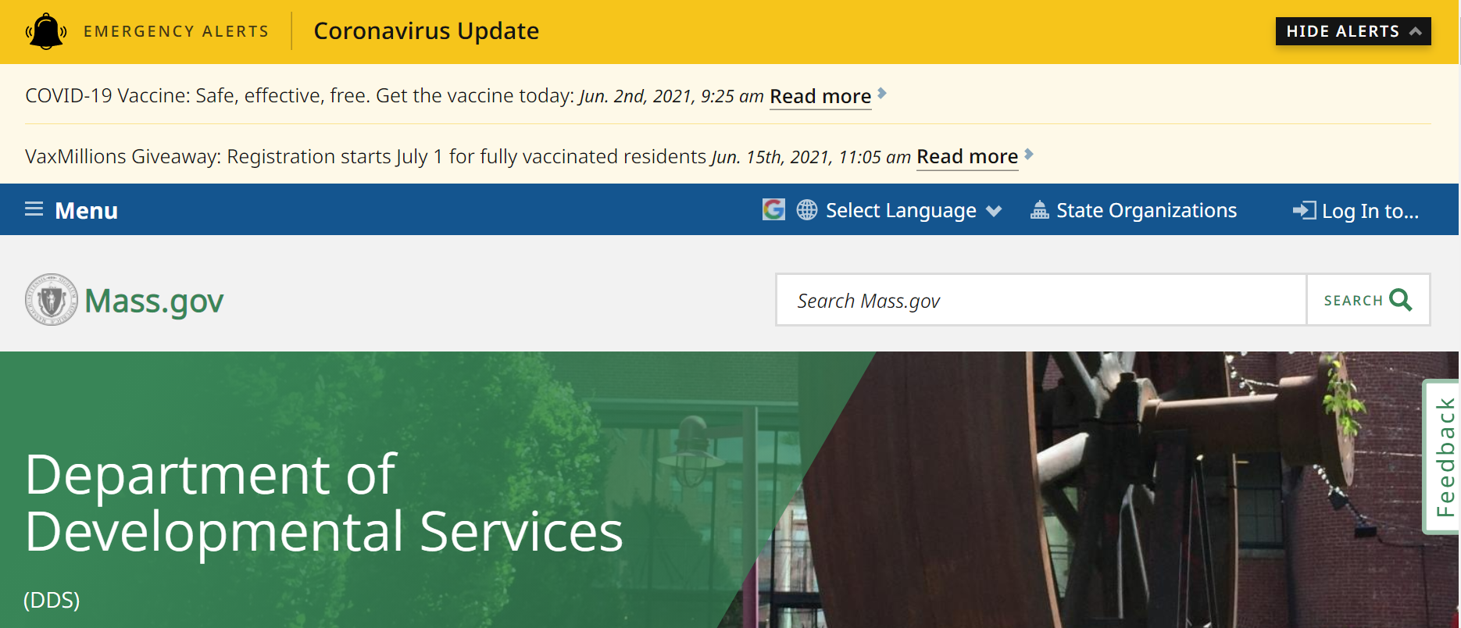
HCSIS Navigation
Step 1 Navigate to Virtual Gateway
Step 2
Enter Login Credentials
Step 3
Select HCSIS
Step 4 View HCSIS Home Page
Step 1: Using the DDS website, navigate to the “Log In to…” link, and then click to get to the Virtual Gateway link: https://sso.hhs.state.ma.us
5

Slide 6
HCSIS Navigation
Step 1 Navigate to Virtual Gateway
Step 2
Enter Login Credentials
Step 3
Select HCSIS
Step 4 View HCSIS Home Page
Step 2: Enter Login Credentials
– Enter your Username and Password
Enter the Username and Password that you use to access HCSIS.
6

Slide 7
HCSIS Navigation
Step 1 Navigate to Virtual Gateway
Step 2
Enter Login Credentials
Step 3
Select HCSIS
Step 4 View HCSIS Home Page
Step 3: Select HCSIS
– Select “Developmental Services Quality Management Reporting (HCSIS)” to access HCSIS
Select the HCSIS link to be redirected to the module.
7

Slide 8
HCSIS Navigation
Step 1 Navigate to Virtual Gateway
Step 2
Enter Login Credentials
Step 3
Select HCSIS
Step 4 View HCSIS Home Page
Step 4: View the HCSIS Homepage
8

Slide 9
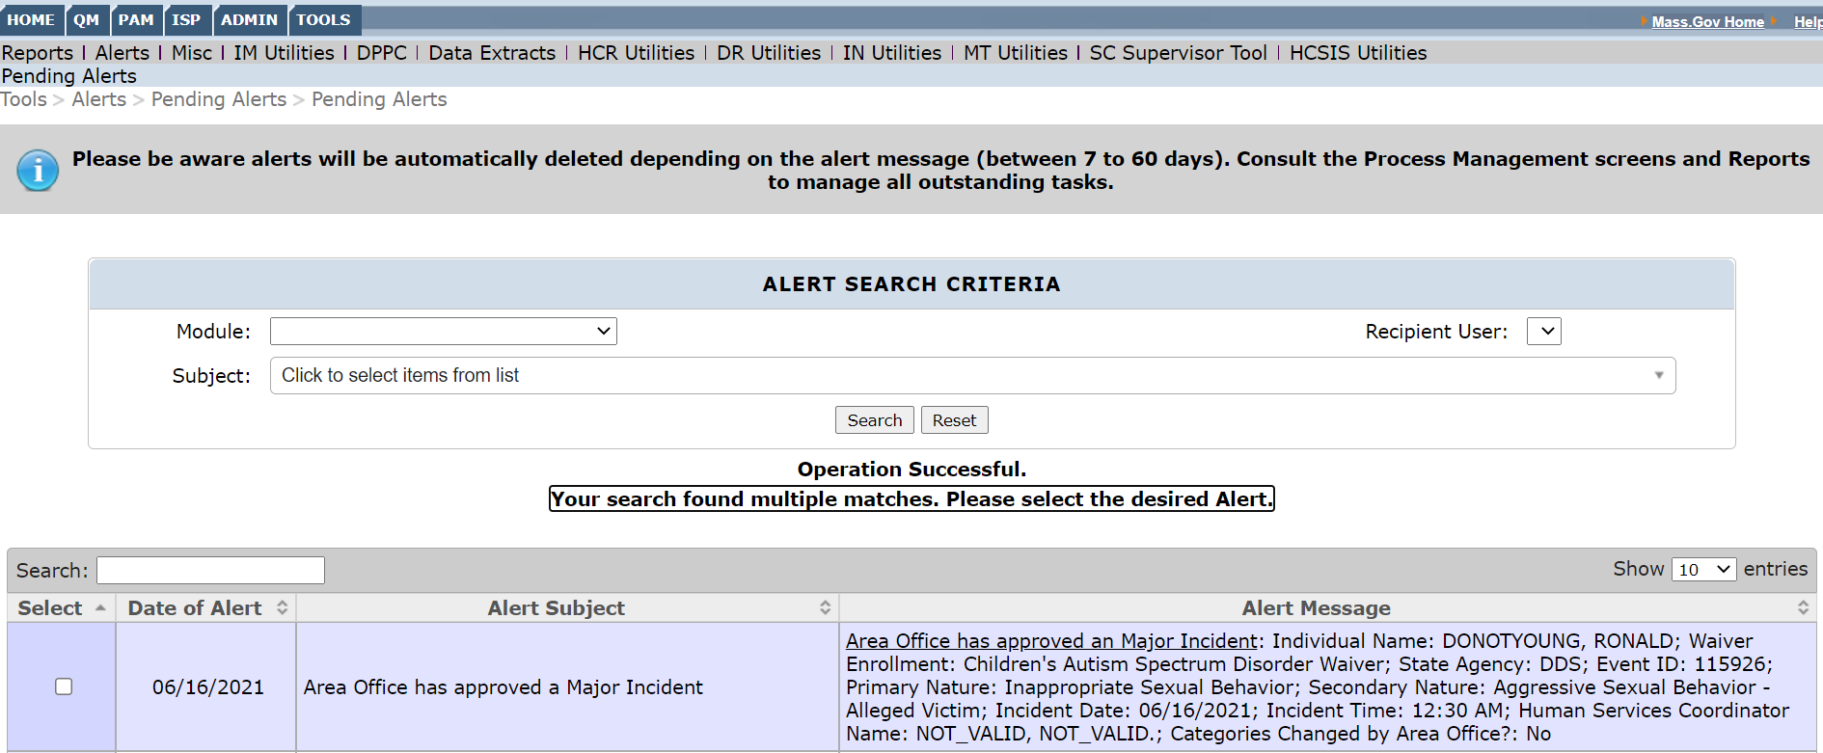
HCSIS Navigation to Alerts
Both Supports Brokers and Clinical Managers receive alerts throughout the Incident Management process in HCSIS. The alerts are not available through email, so communication via phone or email is still important.
9

Slide 10
HCSIS as an Incident Management System

Slide 11
From Incident Reporting to Incident Management
The system enables us to not only report incidents but perform incident management.
What makes a good incident management system?
Identifies adverse events, potential jeopardy and factors related to risk
Notifies key people
Triggers response to protect individual and minimize risk
Closes loop with agreeded upon action steps
Has the ability to collect and analyze information
Has the capacity to identify patterns and trends to guide service improvement
Has thresholds for what is important
Reports important events to key people
Includes levels of review dependent on the severity of the incident

Slide 12
Benefits of Incident Management Tool
Gives ability to sort data for planning
Individual
Site
Agency
Area/Region/State
Analyses are conducted on the data
Missing Persons
Unexpected Hospital Visits
Significant Behavioral Incidents
Individual Trends

Slide 13
Incident Management Responsibilities and Roles

Slide 14
Incident Management Responsibilities
Support Broker
Responsible for:
Submitting the initial and final incident report via HCSIS
Revising and resubmitting the incident report, if necessary
DDS
Responsible for:
Conducting the first and
second level of review
First-Level:
- Clinical Manager
Second-Level:
-Autism Program
Director
Revising incident categories, if necessary
Returning the incident report to providers, if necessary
Approving/ closing the incident
Recommending/ classifying the incident as a Critical Incident
15

Slide 15
Incident Report Submission and Review Timeline

Slide 16
Incident Reporting Timeline
DDS Completes Follow-Up Action Steps Document
DDS
Conducts Clinical Manager Review
DDS Conducts Autism Program Director Review
Supports Broker Submits Initial Report
Supports Broker Submits Final Report
Incident Discovered
≤ 3 day / minor
Workflow
≤ 1 day / major
≤ 7 days
≤ 7 days
≤ 7 days
Approve OR
Not Approve
Approve OR
Not Approve
Closing Reports
If the incident is minor, the event is considered closed once the Clinical Manager finalizes and approves Clinical Manager Review and has not created a Follow-Up Action Steps document.
If the incident is major, the event is considered closed once the Clinical Manager finalizes and approves the Clinical manager Review and the Autism Program Director Review, and has not created a Follow-Up Action Steps document.
The Follow-Up Action Steps document is a mandatory document if the Supports Broker has entered action steps in the final report, or regardless of entry of action steps by a Supports Broker, DDS determines that there are additional action steps to be entered and have created a corresponding Follow-Up Action Steps document in HCSIS.
Note: The Incident report will remain open until the Follow-Up Action Steps document has been finalized.
21

Slide 17
Key Incident Management Terms
The following terms will be used frequently throughout the training.
Term | Definition
In-progress | This term is used when a document has been created but is not submitted or finalized
Submitted | This term is used when the initial report has been completed
Finalized | This term is used when the final version of a document has been completed and sent to the DDS Clinical Manager Note: a finalized report is not necessarily approved
Approved | This term is used when the report has been closed and approved at all necessary levels of review
Not approved | This term is used when the report requires additional descriptive information or clarification
Clinical Manager Review | The Clinical Manager Review is the first level review for all incidents. For incidents that require a minor level of review, this is the only review necessary
Autism Program Director Review | The Autism Program Review is the second level of review for incidents that require a major level of review
22

Slide 18
Incident Report Components and Submission
Process

Slide 19
Incident Report Components
An incident report must be completed for any incident that can compromise the health ,
safety and well-being of an individual. The incident report has two sections:
Initial Incident Report
Final Incident Report
Initial Incident Report
Final Incident Report
The initial incident report is completed immediately after the incident is discovered.
There are 7 sections of the intial report:
The final incident report is completed within a week of the initial incident report and fills in any gaps and builds upon the initial incident report.
Individual Information
Filing Agency Information
Incident Classification
Incident Description
Actions Taken
Involved Parties
Notifications
There are 5 sections of the final report:
Hospital Visit (only appears if primary incident category is Unexpected Hospital Visit)
Additional Information
Follow Up Action Steps
Involved Parties
Verification of Time and Categorization

Slide 20
Details Required in Initial Incident Report
In HCSIS, some of the fields in the Incident Report will pre-populate from MEDITECH. Others will be required to be entered manually. The type of details that are required to be manually input are listed below:
Basic Information
Injury Information
Specific Questions
Who, what, when, where?
Filing agency information
Individual getting superivsion as required?
Incident Description
Incident Cateogry
Cause of injury
Brief description
Type of injury
Body part affected
Ingestion of non-food items?
Unauthorized use of drugs or alcohol
Suicidal threat/ideation
Non-compliance with medical directive or medication
Notifications
Immediate Actions Taken
Involved Parties
Have the following groups been notified?
DPPC
Guardian
Agency on-call
Actions taken to protect the health, safety and rights of the individual
What actions were taken
Who took these actions
Who completed the incident report
Eyewitneses
Who discovered the report

Slide 21
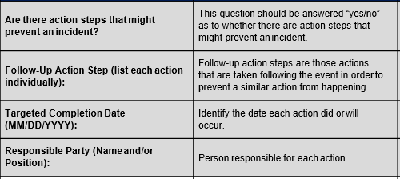
Final Report and Follow Up Action Steps
The Final Report allows the opportunity to correct or update information from the initial
report before submitting the final report for review. Screens are:
Hospital Visit – Information regarding the hospital admission, course, and discharge.
Additional Information: Any updated information for incident description.
Follow-Up Action Steps – Corrective action steps that has been or will be taken to prevent the incident from occurring in the future
Involved Parties – Individual as well as other people who may be involved with the incident
Verification of Time and Categorization – Filing agency, date and time of the incident and Primary and Secondary categories of the incident

Slide 22
Incident Report Creation
Step 1:
Navigate to the QM>IM>Data Entry tab from the Home Page

Slide 23
Incident Report Creation
Step 2:
Enter Last Name/First Name of Individual and click New Individual Incident.

Slide 24
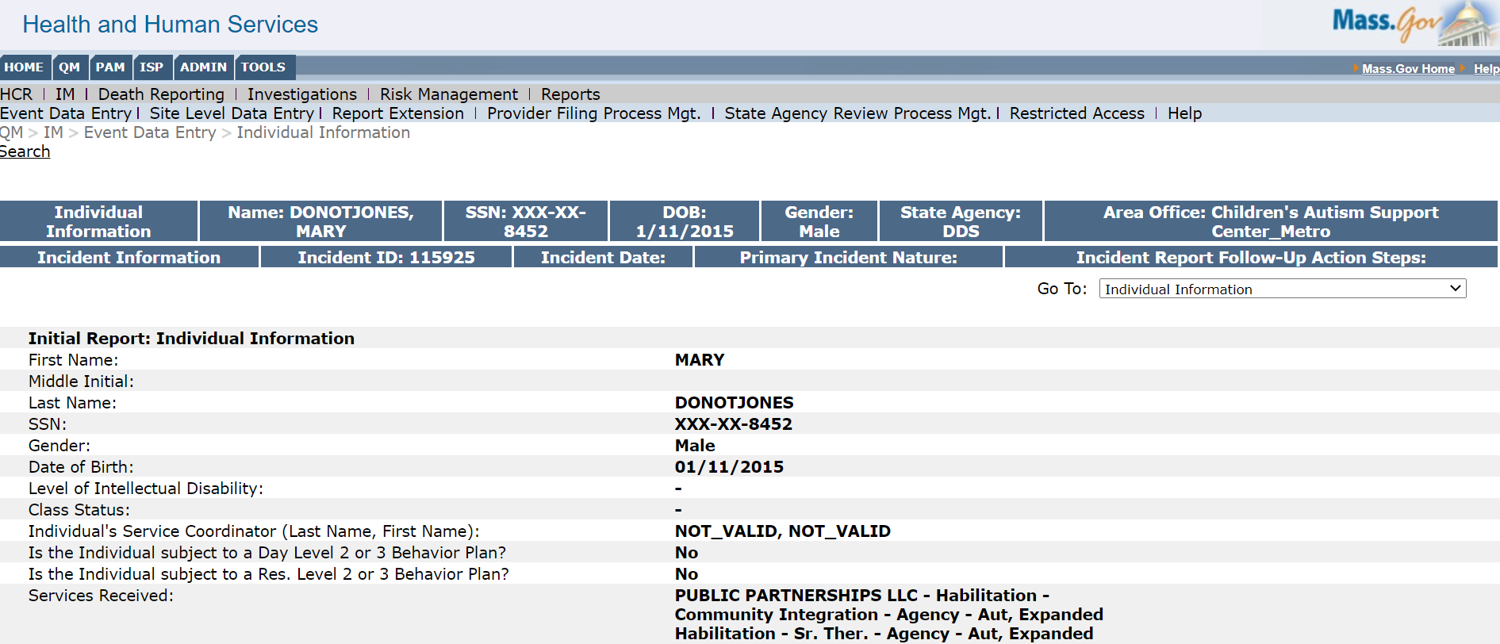
Incident Report Creation
Step 3: Enter data on all screens.

Slide 25
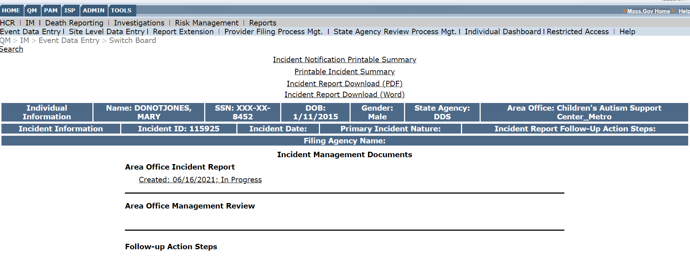
Incident Report Creation
Step 4: Incident report will appear as In Progress, until Submitted and Finalized.

Slide 26
Incident Categorization

Slide 27
Why Use Incident Categories?
They are foundational to the system
They provide criteria for what should be reported
They set thresholds for reporting
Primary Category
Secondary Category
Identifies reportable events
Identifies specific types of events
within a primary category
Not every primary category has a secondary category.

Slide 28
Tips for Choosing a Category
Tips for navigating the Incident Categories:
Incident categories determine if the incident defaults to be a Major or Minor incident.
Those categories that default to being a minor-incident, however, can be escalated by the clinical manager to be a major incident. Clinical Manager should always escalate an incident if it meets one of the following criteria:
Suspected mistreatment where there is a life threatening result,
Staff action or failure to action that exposes the individual to serious personal or public safety risk,
Has the potential for broad, negative publicity in the media or,
Involves law enforcement in any capacity

Slide 29
Tips for Choosing a Category (Cont.)
Tips for navigating the Incident Categories:
Some types of incidents should always be escalated to “Major” level of review
Any incident with police involvement in any capacity
Any incident involving ingestion of a non-edible
Any incident of “fire” started by an individual
The level of review for an unexpected hospital visit depends on the reason for the hospital visit
Most unexpected hospital visits default to a minor level of review. However, the reason for the visit will determine whether or not the system automatically escalates an incident to a major level of review

Slide 30
Individual Incident Categories
There are 17 Primary Incident Categories
# | Primary Incident Categories
1 | Unexpected/ suspicious death
2 | Suicide attempt
3 | Unexpected hospital visit
4 | Inappropriate Sexual Behavior
5 | Victim of Physical Altercation
6 | Significant Behavioral Incident
7 | Missing Person
8 | Medical or Psychiatric Intervention Not Requiring a Hospital Visit
9 | Fire
10 | Suspected Mistreatment
11 | Property Damage
12 | Theft
13 | Other Criminal Activity
14 | Transportation Incident
15 | Emergency Relocation
16 | Unplanned Transportation Restraint
17 | Other

Slide 31
Individual Incident: Unexpected/ Suspicious Death
Description
An individual’s death is unanticipated due to his or her current health status Individual has no identified health needs or may have health needs, such as diabetes, that are managed so death is not anticipated. Excludes expected death such as someone in hospice care
Secondary Categories
Accidental Suicide Unusual circumstances Other unexpected/suspicious death
Level of Review
All unexpected/suspicious death incidents require a major level of review

Slide 32
Individual Incident: Unexpected Hospital Visit (1/2)
Description
An unplanned emergency room visit to acute care hospital occurs for evaluation and treatment of immediate medical or psychiatric concern
Does not include planned hospitalizations
Does not include urgent care visits
Carefully identify the reason for the hospital visit. The reason for visit will determine whether or not the incident the system automatically escalates the incident to a major level of review
Requires additional information:
Length of time in emergency room
Admission date and name of hospital
What occurred during the visit
Discharge information
Remains open until the individual is discharged
A report extension can be requested to finalize the Incident Report

Slide 33
Individual Incident: Unexpected Hospital Visit (2/2)
Secondary Categories
E.R. Visit Emergency Psychiatric Services Evaluation Medical Hospitalization Psychiatric Hospitalization
Level of Review
Unexpected hospital visits sometimes require a major or minor level of review depending on the reason for the visit
30

Slide 34
Individual Incident: Medical or Psychiatric Intervention Not Requiring a Hospital Visit
Description
Treatment beyond first aid is required that does not amount to a hospital visit Includes urgent care visits
Secondary Categories
Medical - applies when an individual has an emergency medical need requiring treatment beyond first-aid but is treated outside of an emergency room. Examples include: A medical need, such as a wound closure, addressed by a medical professional in non-hospital setting, such as the health care practitioner’s office or an urgent care setting Evaluation of possible injury by emergency personnel in response to a 911 call Ingestion of non-edibles and consultation by medical staff or poison control Psychiatric- applies when an individual has a psychiatric emergency. Mobile Crisis Team (CBHI) is called while a child is receiving waiver services. This should be reported in HCSIS “Psychiatric Intervention not Requiring a Hospital Visit”
Level of Review
All medical or psychiatric intervention not requiring a hospital visit incidents default to a minor level of review

Slide 35
Individual Incident: Inappropriate Sexual Behavior
Description
Unwanted advance, contact or activity occurs or credible threats of rape or violent sexual activity are made
Secondary Categories
Aggressive Sexual Behavior - Alleged Victim Aggressive Sexual Behavior - Alleged Perpetrator Sexual Misbehavior - Alleged Victim Sexual Misbehavior - Alleged Perpetrator
Level of Review
Aggressive sexual behavior incidents require a major level of review and sexual misbehavior incidents default to a minor level of review

Slide 36
Individual Incident: Significant Behavioral Incident
Description
Behavioral episodes occurs that could result in serious harm Behavior that can cause public disturbance or a scene Behavior that involves the police This can be a difficult category to determine whether or not the incident should be reported, so review the “HCSIS Decision Tree” in References Questions to help in determination Chart with guidance for reportable/not reportable events
Secondary Categories
Not Involving a physical altercation Involving a physical altercation
Level of Review
All significant behavior incidents default to a minor level of review

Slide 37
Individual Incident: Missing Person
Description
An individual is missing and considered at risk.
Secondary Categories
Law enforcement contacted Law enforcement not contacted
Level of Review
A missing person can result in either a minor or major level of review

Slide 38
Individual Incident: Fire
Description
An event which involves fire. This includes if smoke detectors go off because of malfunctioning or carbon monoxide detectors and the fire department comes Fire started by the individual always needs an individual incident report for that individual; If the incident meets certain criteria related to the secondary incident categories, it could be classified as a site-based incident
Secondary Categories
Known origin – Not started by individual Known origin – Allegedly started by individual Fire – Source unknown
Level of Review
All fire incidents default to a minor level of review

Slide 39
Individual Incident: Suspected Mistreatment
Description
Intentional or negligent action or omission occurs that causes or exposes an individual to a serious risk of physical or emotional harm
Secondary Categories
Alleged victim of psychological abuse Alleged victim of verbal abuse Alleged victim of physical abuse Alleged omission – Failure to Provide Needed Supports Alleged omission – Failure to Provide Needed Supervision
Level of Review
All suspected mistreatment incidents default to a minor level of review

Slide 40
Individual Incident: Other
Description
An event does not fit into an existing category but meets the threshold for a reportable event: Event puts the individual at risk Key people need to be notified in a timely manner Response needed for protection and to minimize risk Should RARELY be used!
Secondary Categories
None
Level of Review
All “other” incidents default to a minor level of review

Slide 41
Use of “Other”
Before submitting an incident categorized as “Other,” you should:
Review all incident category definitions to confirm the event does not fit an existing incident category
Confirm the event meets the threshold of an incident (comprises the immediate safety and well-being of the individual)
Avoid using “Other” unless the event rises to the level of an incident and truly
does not align with one of the existing incident categories.

Slide 42
Policy for Incident Management Categories and
Notification Guidelines

Slide 43
Unwitnessed Events
Events that can compromise the safety and wellbeing of an individual must be reported, regardless of whether or not they were directly witnessed. The incident report must be filed by whomever learned of the incident.
This means that if an individual tells a support broker/clinical manager about an incident that occurred while the individual was:
At home,
In the community
Then the incident must still be reported. If the incident occurred while the individual was at another Support Broker site and the Support Broker is unclear if it has been reported, the Support Broker who learned of the incident should check HCSIS or follow up with the Support Broker to identify if an incident report has already been created. If a report has not been created, the Clinical Manager has the ability to enter the incident report in HCSIS.
At another provider site,

Slide 44
Notification Requirements
Family/Guardian Notification – Whenever a major level review incident occurs, the guardian of the individual should receive immediate verbal notification that the incident has occurred. For minor level of review incidents, there should be a discussion with the guardian as to what, when and how they wish to be notified. That discussion and the guardian’s decision should be noted in the individual’s record. Written reports should be sent to guardians only upon their request and not as a routine practice
For DCF Filings: The filing of an incident report does not relieve mandated reporters of their responsibility to report suspected abuse or neglect directly to DCF.

Slide 45
Common Reasons for an Incident Report
1. A DCF filing by any Waiver staff
2. An injury to the child while Waiver services are
being provided
3. An injury to a Waiver provider requiring medical
treatment
4. Loss of line of sight on Waiver participant during
a Waiver Session (i.e. the child bolts and the
provider loses sight of the child)
5. An emergency restraint by a Waiver provider

Slide 46
Incident Report Submission and Finalization Demo

Slide 47
Incident Management Area Office / Clinical Manager Review

Slide 48
Incident Reporting Timeline
DDS Completes Follow-Up Action Steps Document
DDS
Conducts Clinical Manager Review
DDS Conducts Autism Program Director Review
Supports Broker Submits Initial Report
Supports Broker Submits Final Report
Incident Discovered
≤ 3 day / minor
Workflow
≤ 1 day / major
≤ 7 days
≤ 7 days
≤ 7 days
Approve OR
Not Approve
Approve OR
Not Approve
Closing Reports
If the incident is minor, the event is considered closed once the Clinical Manager finalizes and approves Clinical Manager Review and has not created a Follow-Up Action Steps document.
If the incident is major, the event is considered closed once the Clinical Manager finalizes and approves the Clinical manager Review and the Autism Program Director Review, and has not created a Follow-Up Action Steps document.
The Follow-Up Action Steps document is a mandatory document if the Supports Broker has entered action steps in the final report, or regardless of entry of action steps by a Supports Broker, DDS determines that there are additional action steps to be entered and have created a corresponding Follow-Up Action Steps document in HCSIS.
Note: The Incident report will remain open until the Follow-Up Action Steps document has been finalized.
21

Slide 49
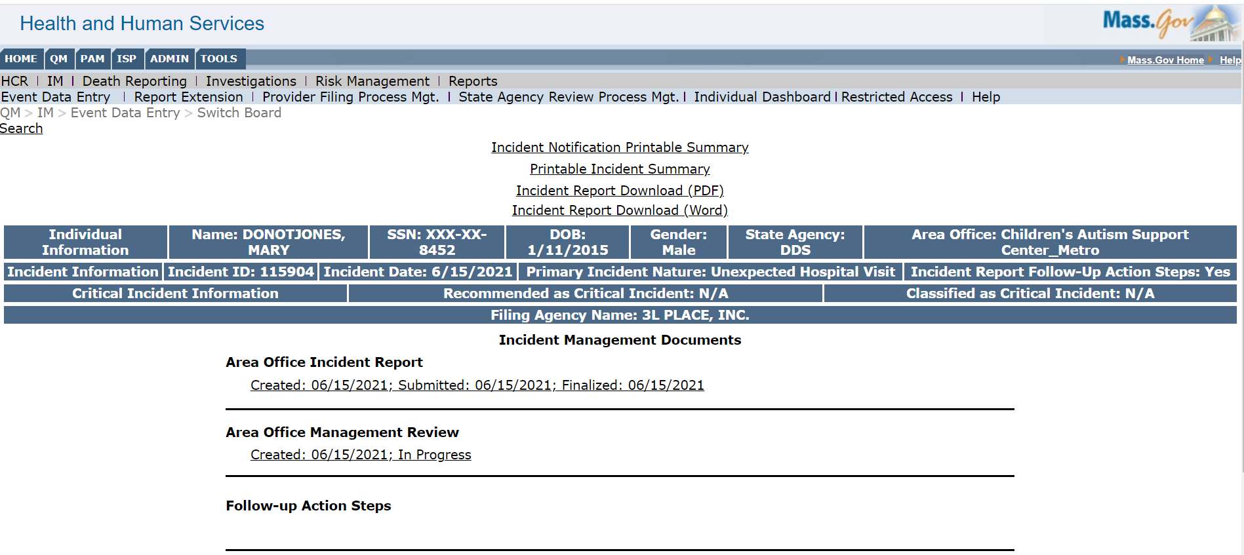
Switchboard for Area Office Management Review Creation
Clinical Manager will perform the Area office Management Review, once they receive an alert that an incident report has been finalized.

Slide 50
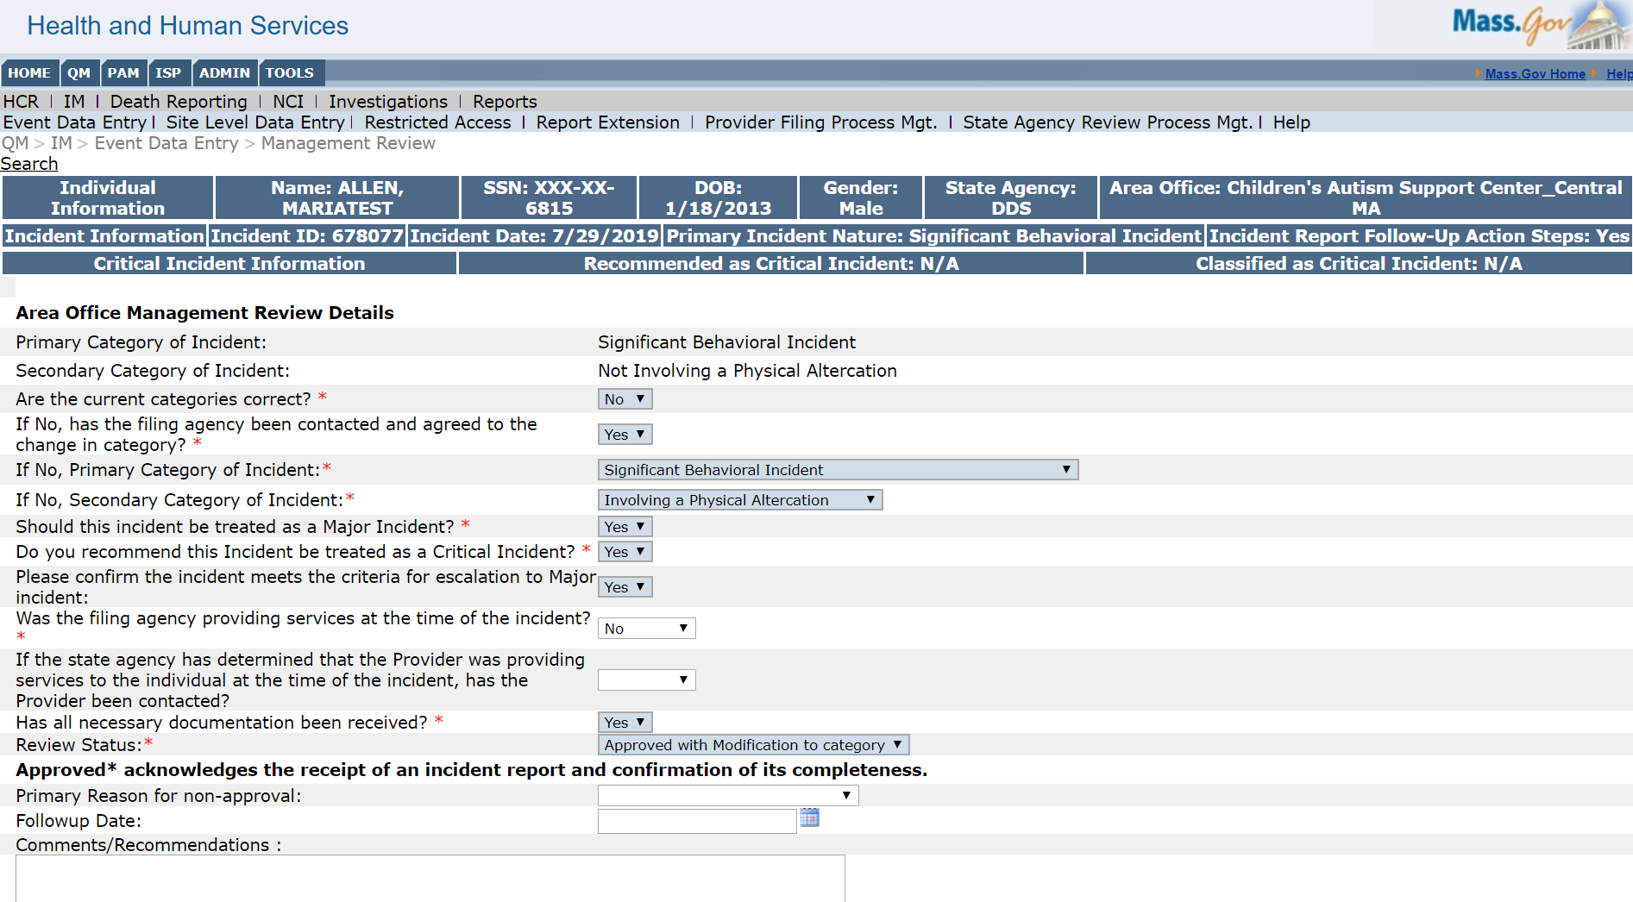
Changing Incident Category
During the review for an incident, if the classification has been determined to be incorrect,
Clinical Managers can change the incident categories selected for that incident
or if the incident has been determined to be of a serious nature, the Clinical Manager can
escalate a minor incident to a major incident.
If DDS chooses to make either change, the Support Broker who submitted the incident will receive an alert
1
2

Slide 51
Critical Incidents
During the review for an incident, if the incident is considered to be of a highly serious nature, the Clinical Manager can recommend a Major Incident or incidents recategorized/escalated to a Major Incident be treated as a Critical Incident.
The Critical Incident status will help HCSIS users to more easily recognize significant incidents and identify behavioral patterns associated to an individual during review.
In the second-level of review, the Autism Program Director will be able to see the Clinical Manager’s recommendation and will make the final decision on whether the incident can be classified as a Critical Incident
3

Slide 52
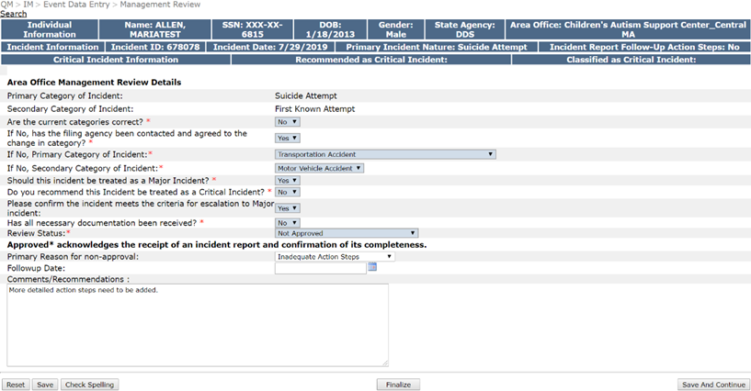
Inadequate Actions Steps
If the follow-up actions steps require revision by the supports broker, the clinical manager must select “Not Approved” and choose “Inadequate Action Steps” as the primary reason for non-approval. Any information regarding why the action steps were inadequate must be entered in the Comments / Recommendations text box for the supports broker to edit accordingly. The incident report will need to be re-submitted once the action steps are updated.
4
Enter information about specific reasons why it is not approved, indicating to the provider what they should do to re-finalize the report, which may include instruction to add/delete/edit action steps or other information.

Slide 53
Key Points for Area Office Management Review
Area Office Management Review:
Disapproval
If not approved, the reason for disapproval must be entered.
If disapproval is due to Insufficient Action Steps:
o Clinical Manager must use Comments/recommendations text box to enter specific reasons why it is not approved, indicating to the provider what they should do to re-finalize the report, which may include add / delete/ edit action steps or other information. Clinical Manager does not have the ability to edit/delete follow-up action steps entered by the supports broker that populate in the DDS Follow-Up Action Steps document.
Approval
If the supports broker selects “Yes” under, “Are there action steps that might prevent an incident?”, “Follow-Up Action Step,” “Targeted Complete Date,” and “Responsible Party” will be mandatory fields on the Final Report.
If the Clinical Manager uses Comments/recommendations text box when the AOMR is approved, and there is meaningful information that should be seen by the supports broker, then the clinical manager should contact directly by phone.
Clinical Manager must wait to receive the re-finalized Incident Report from the supports broker, and then approve, before creating DDS Action Steps document.

Slide 54
DDS Follow-Up Action Steps Document

Slide 55
Incident Management Workflow – DDS Follow-Up Action Steps
If follow-up action steps were entered by the Supports Broker in the Follow-Up Action Steps screen of the final Incident Report, these action steps are populated into the DDS Follow-Up Action Steps document. This document becomes available for the Clinical Manager to create once the Incident Report is approved.
The Follow-Up Action Steps document is mandatory if the supports broker has entered action steps, or if the clinical manager determines that there are additional action steps to be entered. The report will remain open until the Follow-Up Actions Steps document has been finalized.
DDS
Completes Follow-Up Action Steps Document
Supports Broker Submits Initial Report
Supports Broker Submits Final Report
DDS
Conducts First Level Review
DDS
Conducts Second Level Review
Incident Discovered
Workflow
≤ 3 days / minor
≤ 1 day / major
≤ 7 days
≤ 7 days
≤ 7 days
Approve OR
Not Approve
Approve OR
Not Approve
21

Slide 56
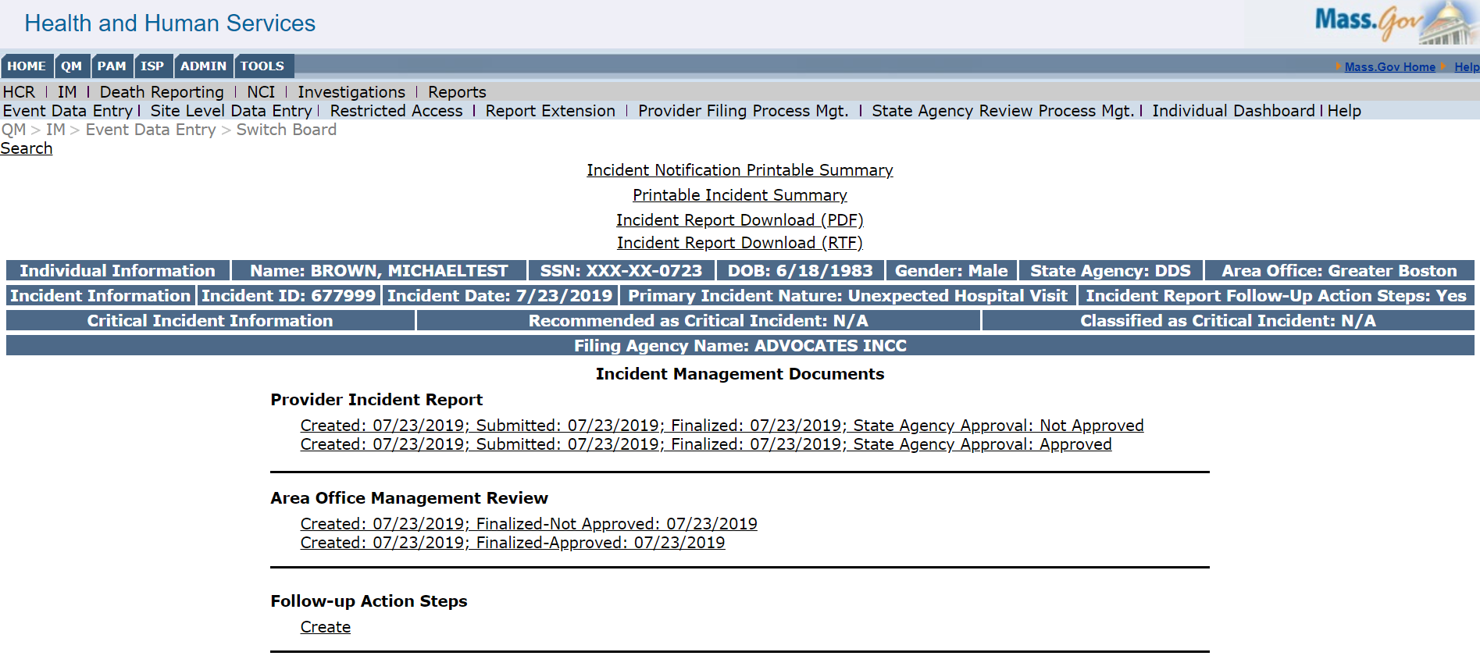
DDS Follow-Up Actions Steps Document – Switchboard
To access the Follow-Up Action Steps document, select the create link in the follow-up action steps section on the switchboard. This document should be completed within 30 days after the approval of the Area Office Management Review.

Slide 57
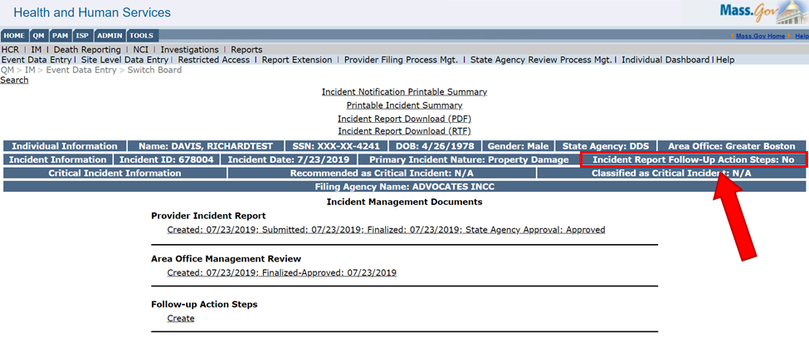
Incident Report Follow-Up Action Steps
Follow-Up Actions Steps (FAS) are identified in the Blue Bar on an Individual’s Incident Report Switchboard. If the Incident Report Follow-up Action Steps indicate “No” on the blue bar, as in the example below, then do NOT click on the Create link for the FAS document unless you would like to create FAS on behalf of DDS.

Slide 58
DDS Follow-Up Action Steps Document
The chart below shows the fields in the “DDS Follow-Up Action Steps” document. The first four fields are auto populated based on information entered by the provider in the Incident Report. The three fields following should be entered by DDS.
Fields | Description | Auto Populated from Provider Incident Report
Are there action steps that might prevent an incident? | This question should be answered “yes/no” as to whether there are action steps that might prevent an incident. | Yes
Follow-Up Action Step (list each action individually): | Follow-up action steps are those actions that are taken following the event in order to prevent a similar action from happening. | Yes
Targeted Completion Date (MM/DD/YYYY): | Identify the date each action did or will occur. | Yes
Responsible Party (Name and/or Position): | Person responsible for each action. | Yes
Was the action completed as recommended? | This question should be answered “yes/no” as to whether the action is completed or not. | DDS should answer for each step, regardless of whether the completion date is in the future when creating this document.
Other comments, if applicable: | Other comments regarding action steps. | DDS should answer for each step – be sure to explain if step was either not completed as recommended, or not yet completed.
Completion Date (MM/DD/YYYY): | Completion date of each action. | DDS should answer for each step, if completed.

Slide 59
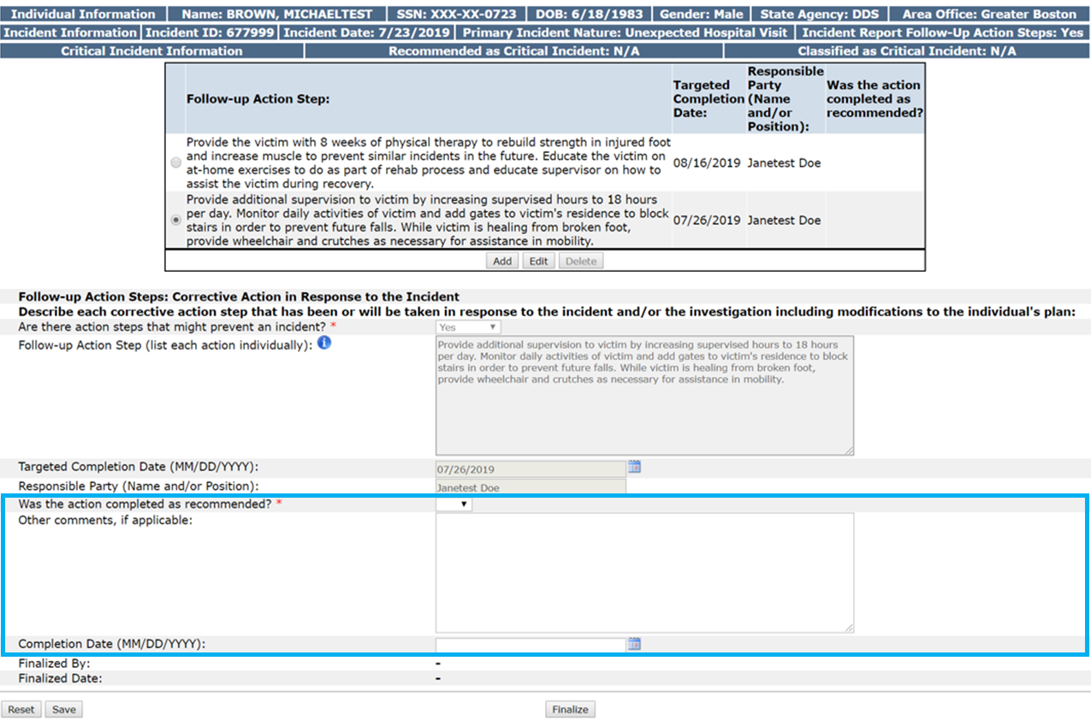
DDS Follow-Up Action Steps Document
The three responses that require manual entry by DDS staff are highlighted below.
Please note: If the action has not been completed as recommended because the targeted completion date is in the future, it is sufficient to answer “No” to Action completed as recommended and then explain in “Other Comments” that the targeted completion date has not yet occurred.

Slide 60
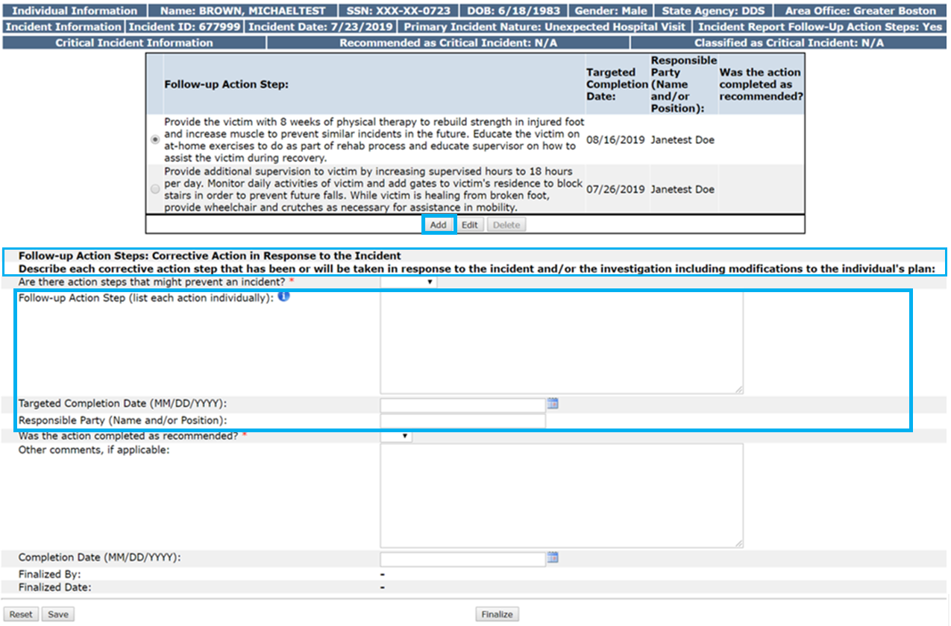
DDS Follow-Up Action Steps Document – DDS Created Steps
DDS can enter their own additional action steps by clicking “Add,” entering text in the fields highlighted below, and then selecting the finalize button.

Slide 61
DDS Follow-Up Action Steps Document – DDS Created Steps
DDS can enter steps in addition to provider steps. Please note that DDS can create a Follow-Up Action Steps document, even if the provider has not entered steps. If DDS does enter steps, it should be done soon after the AOMR is approved. All fields must be completed in “DDS Follow-Up Action Steps”. However, it may be necessary to return to the document at a later date to answer whether the action was completed as recommended, depending on target completion date.
Fields | Description
Are there action steps that might prevent an incident? | This question should be answered “yes/no” as to whether there are action steps that might prevent an incident.
Follow-Up Action Step (list each action individually): | Follow-up action steps are those actions that are taken following the event in order to prevent a similar action from happening.
Targeted Completion Date (MM/DD/YYYY): | Identify the date each action did or will occur.
Responsible Party (Name and/or Position): | Person responsible for each action.
Was the action completed as recommended?: | This question should be answered “yes/no” as to whether the action is completed or not.
Other comments, if applicable: | Other comments regarding action steps. Please, note that this field is mandatory if the follow-up action step was not completed as recommended.
Completion Date (MM/DD/YYYY): | Completion date of each action, if known.

Slide 62
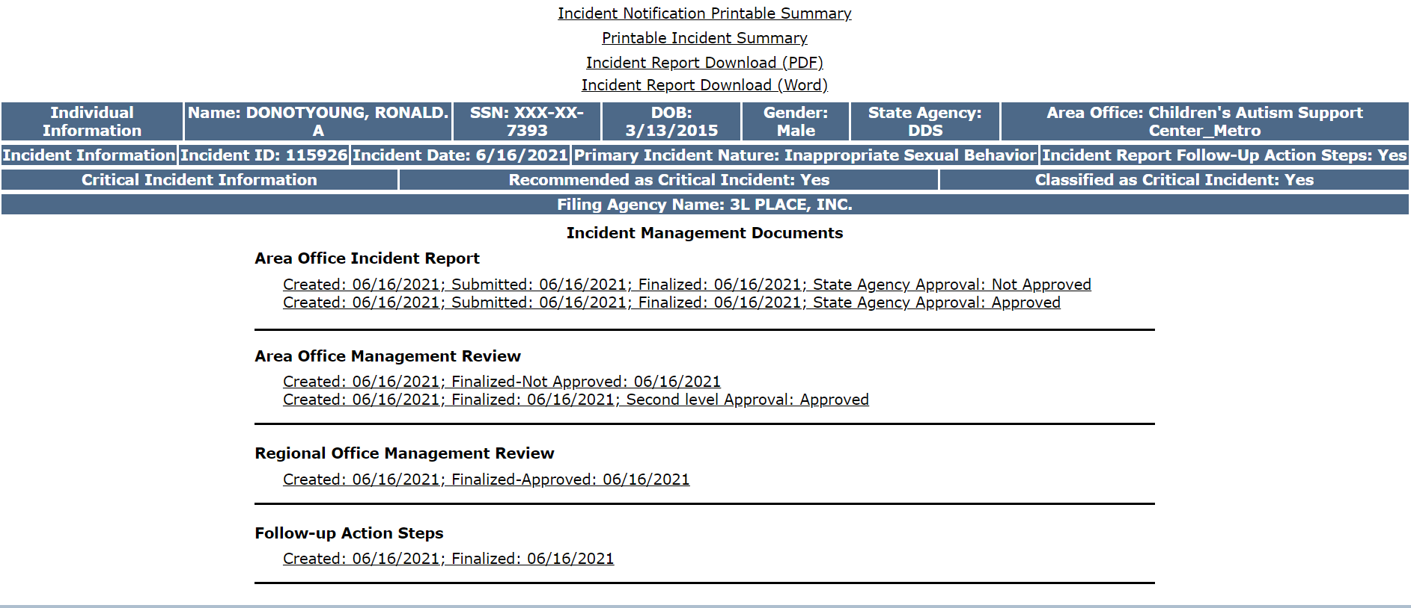
DDS Follow-Up Action Steps Document Finalized
Once the Follow-Up Action Steps document is completed by the clinical manager, the switchboard will show “finalized”. The supports broker and DDS staff will receive an alert indicating that “Follow-Up Action Steps document has been finalized”

Slide 63
Guidance Summary
DDS Follow-Up Action Steps document:
Completion of the Follow-Up Action Steps document is mandatory if follow-up action steps were entered in the Incident Report.
Create and finalize within 30 days after Area Office Management Review is approved.
When the AOMR approves an Incident Report with Follow-Up Action Steps entered, the Clinical Manager for the individual will receive an alert that “Work can begin on Follow-Up Action steps for the Incident”.
For each Action Step entered, Clinical manager must enter all information regarding whether the action step was completed as recommended, other comments, and completion date.
For any additional steps entered by DDS, all information detailing each step must be entered.
If the action has not been completed as recommended because the targeted completion date is in the future, it is sufficient to answer “No” to Action completed as recommended and then explain in “Other Comments” that the targeted completion date has not yet occurred. If “No” is entered for any reason, the “Other Comments” field will be mandatory.
Regional Office user will be able to view the Follow-Up Action Steps document in read-only mode.
The Incident will remain open in the State Agency Review Process Management Screen until the Follow-Up Action Steps document has been finalized.
Once finalized, the provider will receive an alert, indicating that “Follow-Up Action Steps Document has been finalized”
PLEASE NOTE: It is important for DDS to use the STATE AGENCY PROCESS MANAGEMENT SCREEN to monitor the timely closure of Follow-Up Action Steps documents within 30 days of AOMR approval.

Slide 64
Incident Management Area Office / Clinical Manager Review and
DDS Follow-Up Action Steps Document
Demo

Slide 65
DDS to Track Open Incident Reports
Process Management Screens and
Management Reports

Slide 66
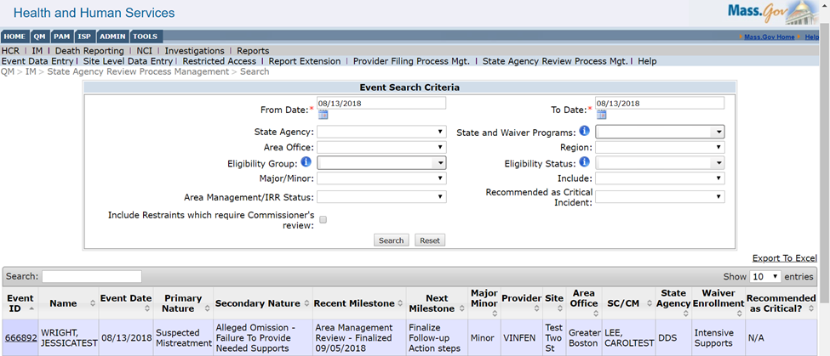
State Agency Review Process Mgt. Screen
If the Incident Report has steps yet to be completed, the State Agency Review Process Mgt. screen will display the report, as it is considered an “open incident.” As an example, the Next Milestone field will indicate “Finalize Follow-up Action Steps” and will remain on the screen until finalized.
This screen is a useful management tool to track open incident reports.

Slide 67
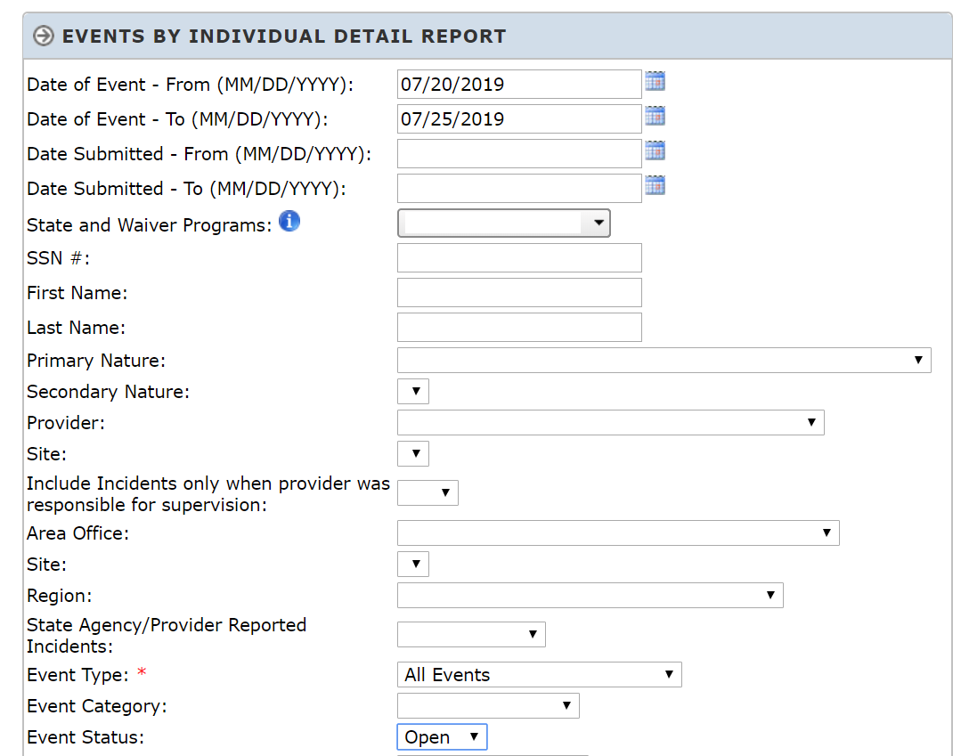
IM Management Reports Screen
Filters can tailor this report to fit your needs. As an example, if the Incident Report has follow-up action steps listed but the Follow-Up Action Steps document has not been finalized, the event will appear as open in IM Management Reports and can be filtered using the open/close status in the report screen.

Slide 68
IM Management Reports Screen
The Events by Individual Detail Report will display events by individual that match criteria inputted in the filters. In this case, the Report will display events that happened in the selected date range with “open” status, and will include those reports that have open Follow-Up Action Steps documents.

Slide 69
Process Management Screens and
Management Reports Demo

Slide 70
Additional Resources

Slide 71
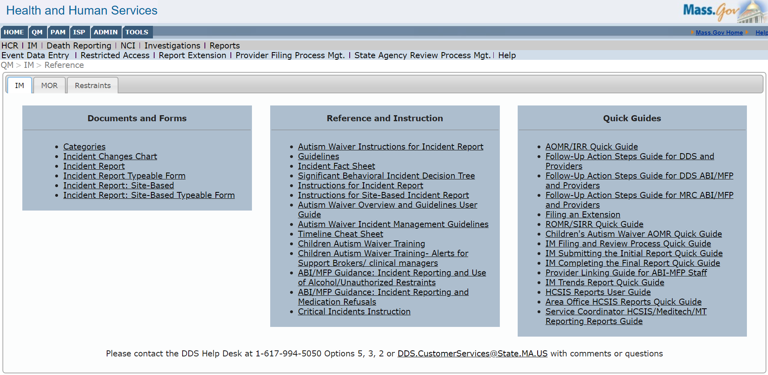
Incident Categories Reference Document
All of the details about incident categories are accessible in the Categories document.
To download the Incident Categories document
Click Help
Click Categories
41

Slide 72
Additional Guidance
If you have any additional questions, feel free to contact the DDS Help Desk.
Support Brokers should also contact the Help Desk as needed.
‒ 617-994-5050, options 5, 3, 2
dds.customerservices@state.ma.us
Hours of operation: 7AM – 7PM M-F
61

