Slide 1
DDS Children’s Autism waiver program 2020 Renewal
Autism Support Broker Training
June 28, 2021
9:00 – 12:00

Slide 2
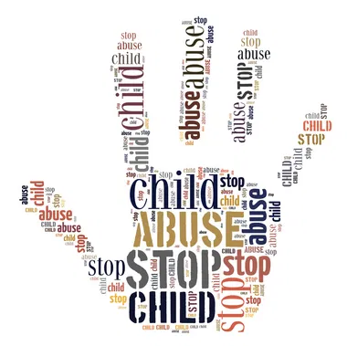
Mandated reporter training
Recognizing & Reporting Child Abuse, Neglect, and Exploitation

Slide 3
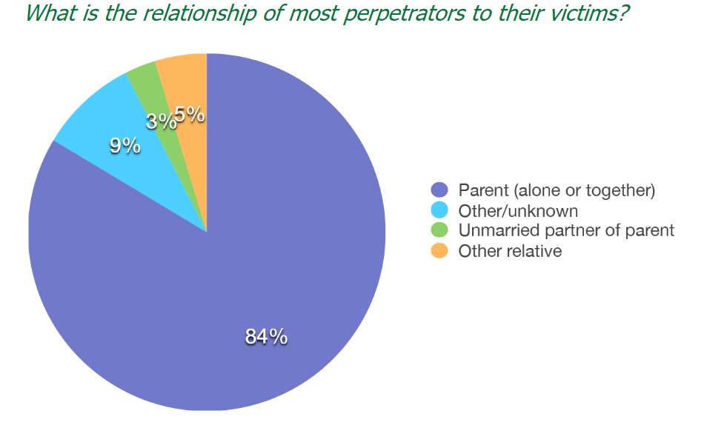
Why is mandated reporting important?
To protect children from maltreatment, including physical abuse, sexual abuse, neglect, and exploitation
Filing a report may prevent or lower the risk of future abuse, neglect, exploitation – or possibly even death
Sobering Stats / Relevant Cases
Notes:
-Children of all ages, races, ethnicities, and economic backgrounds are vulnerable to abuse and neglect
-Additionally, younger children, children with disabilities, and gay, lesbian, bisexual, transgender, questioning youth are more vulnerable to maltreatment.
-Children with disabilities including those with intellectual disabilities, speech and language impairments, emotional disabilities, learning disabilities, and physical health impairments are particularly vulnerable to maltreatment due to factors such as isolation, dependency upon caregivers, family stress, an inability to distinguish abusive from non-abusive acts due to impairment, and difficulties with communication.
Your role as a Mandated Reporter is critical in helping achieve safety, permanency, and well being of for the children in MA
Sobering stats: More than 75,000 reports are received by DCF each year, Every 25 minutes a baby is born suffering from opioid withdrawal, 4 children die each day in the US from abuse and neglect, Over 80% of child deaths due to maltreatment involve children under 4 years old, Nearly 70% of all reported sexual assaults are of children under 18, 1 in 4 girls is sexually abused before turning 18, 1 in 6 boys is sexually abused before turning 18
Overview of Fall River case
When reporting abuse and neglect, we often reference the word “caretaker.” A caretaker is any person who is, at the time in question, entrusted with a degree of responsibility for the child. A caretaker can include a parent ,teacher, a direct support professional, a clinician, or any other person entrusted with responsibility for a child’s health or welfare, regardless of the individual’s setting. A “caregiver” even includes a person who is a child him/herself, such as a babysitter who is under the age of 18.

Slide 4
Am I a Mandated Reporter?
Recognizing Signs
Filing a 51A Report
After Report is Filed
Understanding legal obligations as mandated reporters
Recognizing reportable conditions
Steps on how to file a 51A report
Understanding what happens after a 51A report is filed

Slide 5
Am I a mandated reporter?
While anyone who suspects a child is being maltreated can and should file a 51A Report with the Massachusetts Department of Children and Families ("DCF"), professionals who have been designated by the Legislature as mandated reporters are required by law to do so.
All persons paid to care for or work with a child in any home or program funded by the Commonwealth are mandated reporters.
All program staff, including providers, support brokers, and ACMs are mandated reporters.
Notes:
As a mandated reporter, you are part of the safety net entrusted with protecting the children in our community.
In Massachusetts this is known as the 51A law. Our legislature has designated people who work in certain professions to be mandated reporters. By the very nature of our work, we may be the first ones to be told or see signs of abuse and neglect.

Slide 6
Duties of a mandated reporter
Requires Mandated Reports to File a 51A Report w/ DCF if they have reasonable cause to believe a child currently under the age of 18 is suffering from one or more of the following reportable conditions:
Neglect, including malnutrition
Physical, sexual, or emotional abuse
Financial exploitation
Physical dependence upon an addictive drug at birth
Being a sexually exploited child
Being a human trafficking victim
Notes:
-A mandated reporter may - in addition to filing with DCF - contact local law enforcement authorities and/or the Child Advocate about the suspected abuse or neglect. It is a crime punishable by a fine of up to $1000 for a mandated reporter to fail to file a 51A Report when required .
-It is a crime punishable by imprisonment in jail for not more than 2.5 years and/or a fine of up to $5000 to willfully fail to file a 51A Report when a mandated reporter has knowledge of child abuse or neglect that resulted in serious injury to or death of a child.

Slide 7
Duties of a mandated reporter
If you have reasonable cause to believe a child has died as a result of a reportable condition you must notify:
The Local District Attorney
https://www.mass.gov/orgs/massachusetts-district-attorney-association
Chief Medical Examiner
https://www.mass.gov/orgs/office-of-the-chief-medical-examiner
Notes:
It is not your job to investigate
What is reasonable cause to believe?
A presentation of facts which creates a reasonable suspicion of child abuse, neglect, or exploitation. Absolute proof is not needed.
Your employer cannot retaliate against you for filing a 51A Report in good faith.

Slide 8
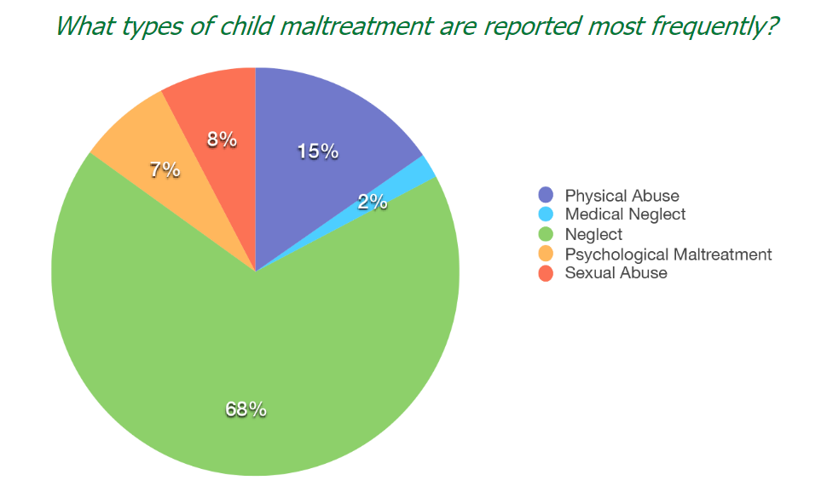
Recognizing reportable conditions

Slide 9
Recognizing Neglect
Neglect is the failure by a caregiver to take those actions necessary to provide a child with minimally adequate food, clothing, shelter, medical care, supervision, emotional stability and growth, or other essential care including malnutrition.
Child neglect indicators may include:
Lack of medical or dental care, immunizations, or glasses
Lack of appropriate clothing for the weather
Chronically dirty or unbathed
Begs for or steals food or money
Lack of supervision
Frequently late or absent from school
Notes:
Neglect is the failure by a caretaker, either deliberately or through negligence or inability, to provide a child with minimal care.
Neglect can be deliberate or through negligence or inability, but it cannot be due solely to inadequate economic resources or due solely to the existence of a handicapping condition.
For example, failure to provide a child with basic hygiene will not inflict any immediate injury, but, over time, will lead to a variety of ailments. A mandated reporter is not required to wait until unsanitary conditions in the home or lack of hygiene have led to infection or disease before filing a 51A Report, which allows DCF to take steps to protect the child from the foreseeable consequences of the neglect.
Reasonable suspicion can be based on a disclosure by a child, an admission by a perpetrator, information from a third party, or your own observations, knowledge, and experience.

Slide 10
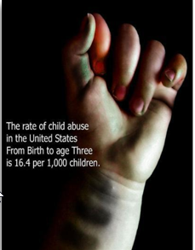
Recognizing physical abuse
Physical abuse is a non-accidental injury.
Physical abuse indicators may include:
Bruises
Burns
Broken bones
Injuries that are patterned
Hitting with a hand, fist, foot, or object
Shoving, tripping, pushing, pulling, pinching, etc.
Extreme fear of parent/caregiver
Notes:
Bruising, welts, or burns that cannot be sufficiently explained
Unusual bruising patterns that reflect the shape of an instrument used to cause injury, such as the shape of a belt – injuries would not occur through normal play and are symmetric on multiple planes of the body
Physical injury such as a facture of a bone or a nontrivial injury
Hitting with a hand, first, foot or object
Shoving, tripping, pushing, pulling, scratching, pinching, cutting, biting
Non-Accidental
Parent or other household member hit or shook a child hard enough to cause injury.
Injuries are inconsistent with the explanation provided.
Bruising on an infant may be suspicious for abuse.
Accidental
Child was injured during normal child play.
Parent or other household member inadvertently injured the child.
Whether the force used was reasonable or excessive in nature
Whether the force was reasonably related to the purpose of safeguarding or promoting the welfare of the child, including the prevention or punishment of misconduct
Whether the force caused or created a substantial risk of causing gross degradation, serious mental or emotional injury, or physical harm to the child
The child’s age
The child’s physical, cognitive, and emotional maturity
The presence, nature, and extent of any physical injuries
Whether a weapon or object was used
The nature of the child’s misconduct
Whether the child had the capacity to understand or appreciate the reason for the punishment

Slide 11
Recognizing sexual child abuse
Sexual child abuse is engaging in a non-accidental sexual act(s) with a child that causes harm/substantial risk of harm to the child’s health or welfare.
Sexual abuse indicators may include:
Recurring pain or itching in genital or anal areas
Frequent bladder or urinary tract infections
Genital injury, including bruising and tearing
Premature sexual knowledge, language, and/or behaviors
Not wanting to be left alone with a particular individual
Wearing multiple layers of clothing
Fire setting
Notes:
Sexual child abuse can be physical, verbal, or written.

Slide 12
Recognizing Financial exploitation
Financial exploitation is the illegal or improper use of another person’s funds, property, or assets by a person in position of trust.
Financial exploitation indicators may include:
Lack of knowledge regarding where the money is going
Inappropriate influence by third party
Opening a credit card in the child’s name
Using social security number to gain employment
Inappropriate use of SSI funds
Notes:
Who commits financial abuse? Family members, significant others, paid and unpaid caregivers, and more
Risk factors: unable to report due to limited communication skills, isolated or dependent on caregivers, may want to please caregivers by giving them money and other resources
If a child is receiving SSI (Supplemental Security Income) the money must be spend on the child’s “maintenance,” which means food, housing, clothing, medical care, and personal needs (hygiene), utilities. SSI can be spent on copays for medication or medical expenses that are not covered. If there is left over money after taking care of child’s basic minimum needs, the payee parent can also spend money on recreational expenses that benefit the child such as sports lessons, tutoring, movie tickets or special camps. They can also set aside a small amount of money in a savings account, such as an ABLE account.

Slide 13
Important observations / Questions
Have there been any physical and/or behavioral changes in the child? Any changes to the caregiver ?
Has the child had any recent doctor’s appointments or trips to the ER? Calls to Mobile Crisis?
Any evidence of infestations in the home?
Any drug paraphernalia like needs, empty alcohol bottles, glass pipes, etc. in the home?
Any safety concerns in the home (e.g., windows with no screens, sharps/poisons/firearms stored appropriately, etc.)?
Notes:
-Have there been any physical and or behavioral changes in the child? (e.g. unhealthy weight loss or weight gain, bruises on body, cigarette burns, rope burns, inappropriately dressed, has the child’s behavior has changed – increase aggressions, withdrawal behavior, frightened of parents?)
-Caregiver indicators -Weight loss to an unhealthy degree, decline in personal hygiene, bloodshot eyes, offers inadequate or inappropriate explanation for the child's injury, personal or partner abuse of alcohol or other drugs,

Slide 14
Suspect reportable conditions?
First:
Make sure child is safe (if situation warrants it, call 911)
Next:
Report suspected abuse or neglect to:
The Department of Children and Families Child-At-Risk Hotline 1-800-792-5200
Report concerns to Autism Clinical Manager / DDS
WHEN IN DOUBT, REPORT!
Notes:
-If someone is disclosing information, ask for clarification rather than assuming information.
-Do not ask leading questions If a child says, “Daddy hurt me,” you should ask “How did Daddy hurt you?” or “Can you tell me what Daddy did?” Do not ask, “Did Daddy hit you with his belt?”
-First, make sure the child is safe. If the situation warrants it, call 911 for police and emergency medical services
-Next, if there is a suspected abuse or neglect, a report must be made to: The Department of Children and Families Child At Risk Hotline
Not sure if something is abuse or neglect? When in doubt, report!

Slide 15
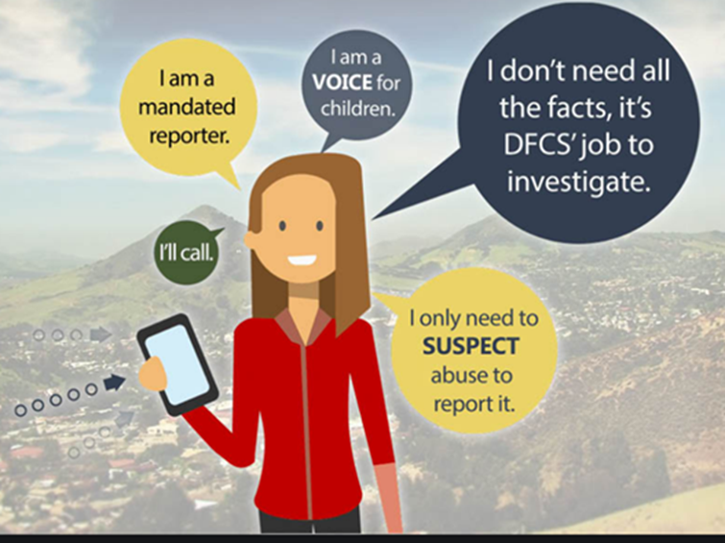
How to file a 51a report
How quickly must I file?
Required to file an oral report immediately & follow-up written report within 48 hours
Who do I call to file my oral report?
During Evenings, Weekends, and Holidays: Call Statewide Child-At-Risk-Hotline: 1-800-792-5200
During Business Hours: Call the local area office covering the city/town where the child lives
Where do I send my written report?
Virtual Gateway
Notes:
Massachusetts General Law c. 119, 51A requires mandated reports to file a report w/ DCF if they have reasonable cause to believe a child is being abused
https://www.mass.gov/files/documents/2020/01/16/Cities%20and%20Towns%20by%20Area%20Office%20-%20updated%202.6.17%20%289%29.pdf → DCF office by city and town

Slide 16
What happens after a 51a is filed?
DCF responds to reports of abuse or neglect 24/7
If there is an immediate concern → investigation & evaluation will begin within 2hrs of initial contact and completed within 24hrs
All other reports → investigation and evaluation will begin within 2 working days of initial contact and completed within 10 calendar days
Notes:
-The Department will investigate cases where the abuse or neglect has been inflected by or caused by a person responsible or entrusted for a child’s health, welfare, or care; or by a person given access to a child by a person responsible
-DCF should take steps to protect the child, including investigating the allegations, offering services to the child and his or her family, taking custody of the child, notifying the local district attorney, and notifying other state agencies, as a mandated reporter you must answer questions and provide information requested by DCF during their response,
-If there is a concern for the child’s immediate health and safety, an investigation and evaluation of the information reported will begin within 2hrs of initial contact and be completed within 24hrs. All other reports, investigation and evaluation shall commence within 2 working days of initial contact and be completed with 10 calendar days.
-DCF may close a case believing issues are resolved. If you see issues arising again, you should file a new 51A Report as DCF may no longer be involved and may not be aware the family needs further intervention.
-Their first priority is to safely stabilize and preserve families. If that is not possible, children may be removed temporarily and DCF’s priority changes to safely reunifying the family. When children are placed outside the home, DCF supports parents as they develop resources and skills that will help them keep their children free from abuse and neglect. If that too fails, children may be permanently removed and DCF’s priority changes to safely creating a new, safe and permanent family for the child.

Slide 17
Pop quiz!
Which of the following may be considered a form of child neglect by a parent:
A. Failure to provide insulin to a child with diabetes
B. Failure to provide school supplies due to cost
C. Threatening to kill your spouse in front of your child
D. A & C Only
Notes:
Which of the following may be considered a form of child neglect by a parent:A. Failure to provide insulin to a child with diabetes
B. Failure to provide school supplies due to cost
C. Threatening to kill your spouse in front of your child
D. A & C Only
Answer: A and C only. A failure to provide school supplies solely due to a lack of economic resources does not qualify as neglect.

Slide 18
Pop quiz!
Do I have to file a 51A Report if I know DCF is already involved with the family?
Zander lives with his parents, Kathy and Joseph. Joseph makes threats to kill Kathy. Kathy fears for her safety. Do you file?
Will my name be protected as a mandated reporter?
Notes:
1. Yes. A new 51A Report needs to be filed for every new incident of maltreatment even if DCF is already involved and providing services to the family.
2. Yes, you should file when the alleged perpetrator makes threats to kill the caretaker, chil(ren), or him/herself and the caretaker fears for his or her safety
3. A mandated reporter's name is protected from disclosure unless ordered by a court. This does not mean the family will not figure out that you filed or ask you if you filed. If you feel comfortable, you can tell the family you are required by law to file. In some situations this may be advisable and provides you an opportunity to help the family understand what to expect. If you do not feel comfortable, you are under no obligation to inform the family you filed.

Slide 19
Scenario
Sandra is 6 years old. She is receiving Supplemental Security Income (SSI). During your visit, you notice that Sandra’s clothes are too small and have several holes. You also notice that there is new furniture in the apartment. You comment on the furniture and inquire if she used a furniture bank in the area.
Sandra’s mother reports that she used a portion of Sandra’s SSI to furnish her new apartment. Sandra’s mother feels that she doesn’t really need all that money, anyway.
What do you do???
Notes:
-if a child is receiving SSI (Supplemental Security Income) the money must be spend on the child’s “maintenance,” which means food, housing, clothing, medical care, and personal needs (hygiene), utilities. SSI can be spent on copays for medication or medical expenses that are not covered. If there is left over money after taking care of child’s basic minimum needs, the payee parent can also spend money on recreational expenses that benefit the child such as sports lessons, tutoring, movie tickets or special camps.

Slide 20
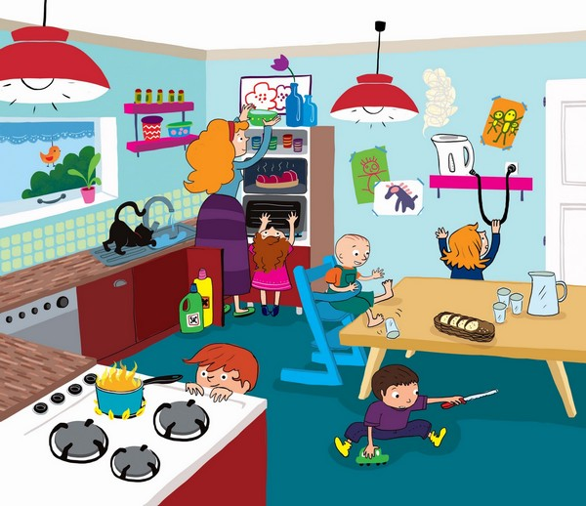
Find the concerns
Notes:
Stove top
Kid with sharps/knife under the table

Slide 21
Additional resources
51A training offered by the Middlesex Children’s Advocacy Center
http://51a.middlesexcac.org/
DCF publications
https://www.mass.gov/service-details/reporting-alleged-child-abuse-or-neglect-filing-a-51a-report
The Department of Children and Families Child-At-Risk Hotline 1-800-792-5200

Slide 22
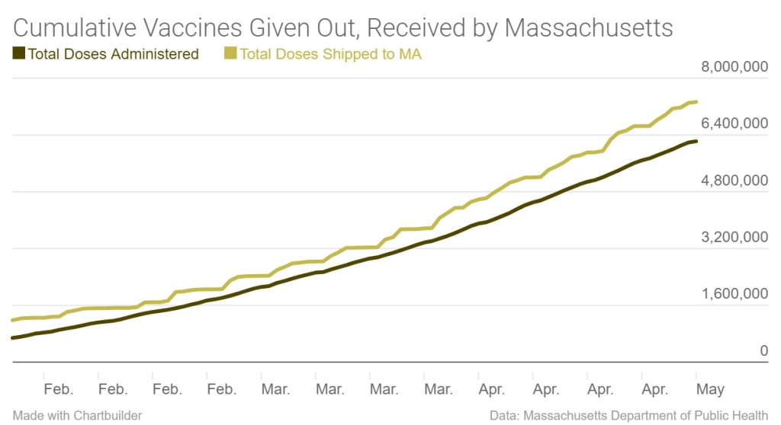
Comments on Life transitioning to our new normal
The Governor has declared an end to the medical emergency caused by COVID and, therefore, has lifted most COVID restrictions
The rate of fully vaccinated individuals in the Commonwealth is high (about 60%, over 4 million people)
Many places of businesses, like restaurants and retail stores, are re-opening or returning to traditional practices
That all being said, many people reasonably still have concerns about their health and safety when moving beyond our pandemic bubbles
We don’t know who has or has not been vaccinated
Some people mistrust the medical field in general and/or vaccinations more specifically
New variants continue to emerge
Graph from: https://www.nbcboston.com/news/coronavirus/chart-heres-when-vaccinations-massachusetts-peaked/2369967/

Slide 23
Comments on Life transitioning to our new normal
While understanding some hesitation, we are collectively moving towards life as we used to know it.
We have a responsibility to our participants’ safety and wellbeing.
ACMs are responsible for putting eyes on the children every 6 months.
Brokers are responsible for putting eyes on the kids every other month.
There is a tremendous emphasis on each of us having eyes on the children, specifically, not in simply meeting with the families.
As we do resume in person meetings, please be aware of your own personal safety, too. Keep your eyes open, abide by current visitation guidelines and procedures published by DPH and the CDC, and attend to local law enforcement instructions when in effect.

Slide 24
Questions?

